Slide 1
NLP Demos (TBC…)
Tuesday December 16th Afternoon | Friday December 19th Morning | Friday December 19th Afternoon
14:15-14:45 Ravin Shalmashi, Paschal Chukwubuikem Ifewulu, Martin Zhelyazkov | 8:30-9:00 Natan Wojtowicz, Tijl Cleynhens,Tuur Mentens 9:00-9:30 Mateo Donado González, Núria Padilla Sánchez, Alexander Hoegen-Jupp 9:30-10:00 Julia Drygalska, Thomas Van Sande, Pierina Lopez 10:30-11:00 Alexandros Giorginis, Marin Janushaj, Yunus Eren Ertas

Slide 2


Slide 3
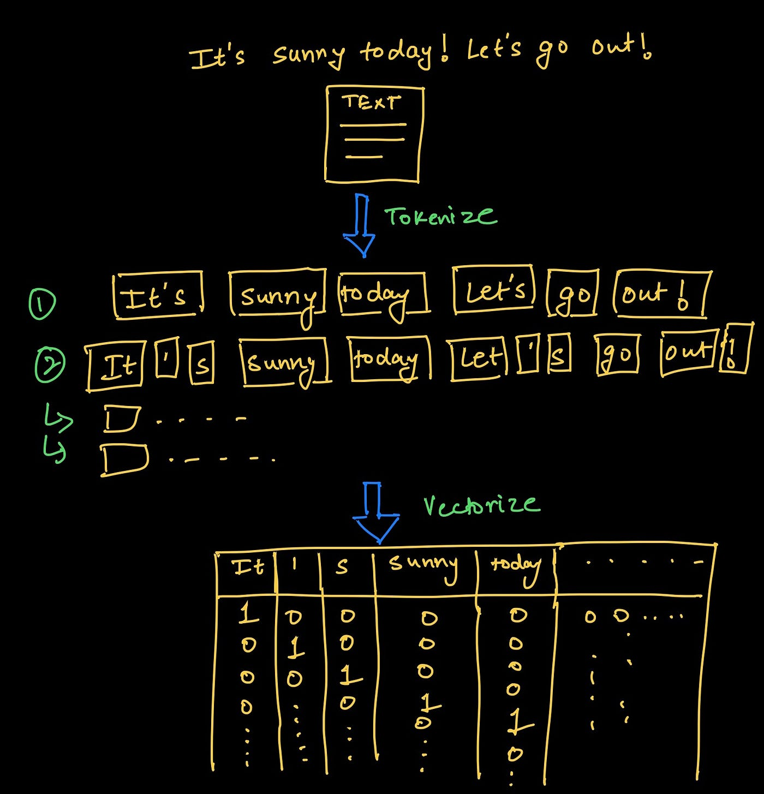
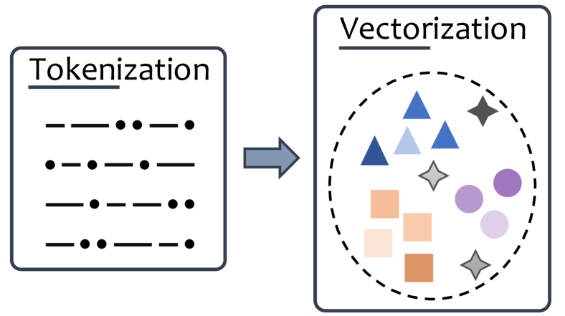
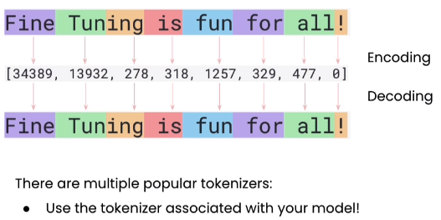
Tokenization & Vectorization
Notes:
Vectorization

Slide 4
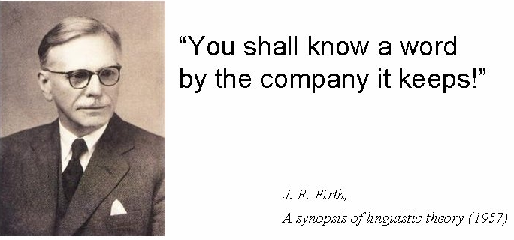
Distributional hypothesis
Notes:
To obtain a semantic embedding space, the model must somehow learn what words mean and meaning in language comes from context.
This idea comes from linguist J.R. Firth (1957) and is known as the distributional hypothesis. It means that words appearing in similar contexts tend to have similar meanings.
LM operationalize distributional hypothesis for representation learning.

Slide 5
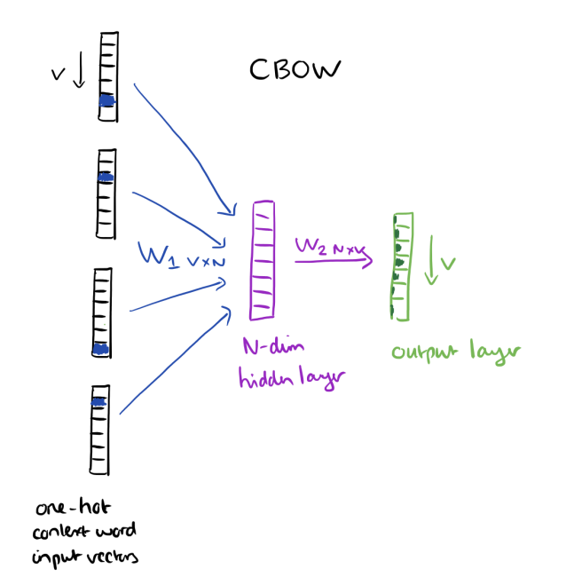
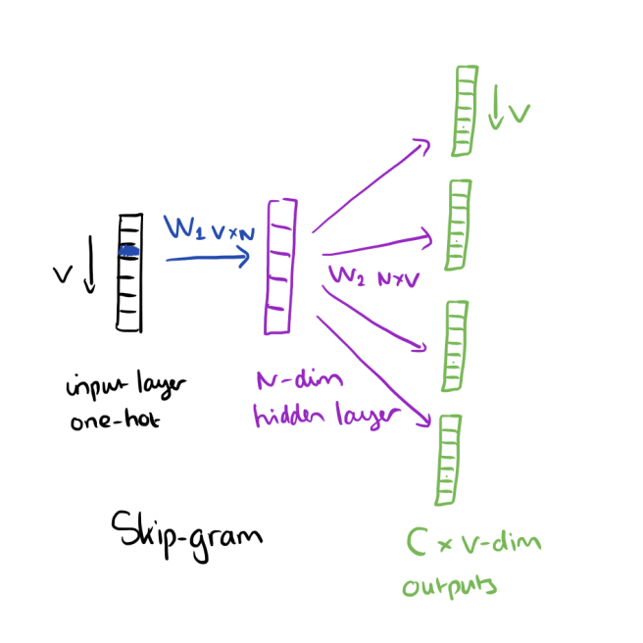
Word2Vec
“Predict a word, given the context”
Weights of trained network are compressed representation of word
“Predict the context, given the word”
Words that are contextually closer, will be closer in vector space!
Notes:
Semantic embedding space learning through self-supervision

Slide 6
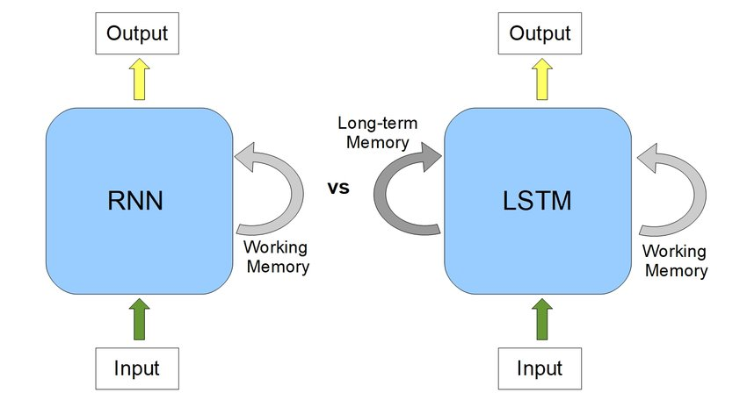
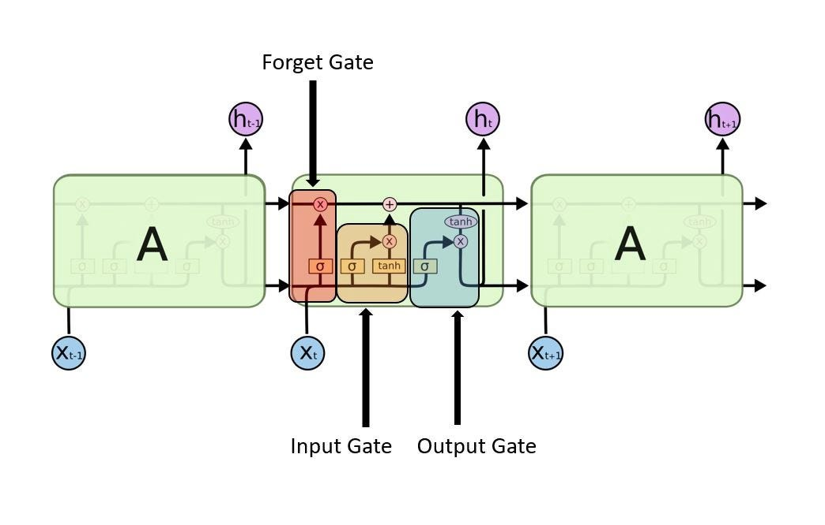
RNN vs LSTM
RNN challenges: long term dependency & vanishing gradients
LSTM solution: add long-term memory connection
Notes:
RNN
The hidden state vector is the RNN’s dynamic internal representation, a compressed memory of everything seen so far: a memory, context-dependent word embedding,
Because of vanishing gradients, the hidden state tends to be dominated by recent inputs. As a result, the RNN struggles to connect distant parts of a sentence or sequence.
So while it processes text sequentially, the effective memory span is very short. Furthermore, at each timestep, the RNN updates its hidden state by blending the new input with the old hidden state. This update is uncontrolled — new information can easily overwrite older, still-relevant information.
LSTM
Cell state or long-term memory
This is the main memory of the LSTM — a kind of “conveyor belt” that runs through the sequence.
Information can flow along it with minimal changes, allowing the model to remember things over many timesteps.
The forget gate and input gate decide what gets removed or added to this memory.
Because it can carry information almost unchanged, it helps solve the vanishing gradient problem.
Hidden state or short-term memory
The hidden state is derived from the cell state.
It represents what the LSTM “shows” to the next layer or timestep — the visible part of its understanding at that moment.
The output gate controls how much of the cell state is revealed through the hidden state.
Because it changes more rapidly, it captures short-term, contextual information — the current interpretation of the sequence.

Slide 7
LSTM: Limitations
Sequential processing: Must read tokens one by one which is slow
Long-distance dependencies: Memory fades with distance, even with gates
Limited context window: Only remembers part of long text
Fixed-size hidden and cell state: One vector must store all past info
Memory, parallelization and long-range dependency problems
Notes:
Still limited for large-scale language modeling, because of:
Cannot be parallelized → slow training
Information bottleneck
Poor at modeling documents or long conversations

Slide 8
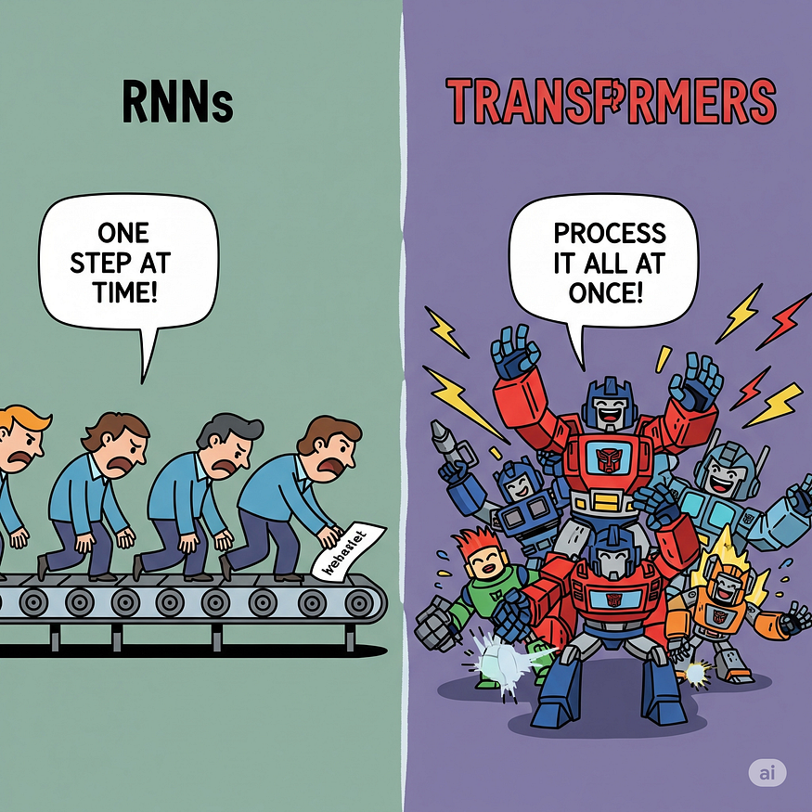
RNN/LSTM vs. Transformer
Notes:
https://medium.com/@anagharamdas2000/a-beginners-guide-to-the-logic-of-transformers-powering-modern-ai-e21be8b02286
Remove recurrence, only use attention which enables parallel computing

Slide 9

Paradigm Shifts in NLP
Frequence- based features
Neural word embeddings
RNN models
LSTM models
Seq2seq models (with attention)
Transformers and LLMs
Pre-trained language models
Notes:
NLP has gone through several major paradigm shifts. Each step listed corresponds to a fundamental change in how NLP problems were approached, what kind of representations were used, and what capabilities became possible.
What shifted? Frequency → Embeddings From discrete to distributed representations
Embeddings → RNN/LSTM From word-level to sequence-level modeling RNN → Seq2Seq + attention From fixed architecture to flexible encoder–decoder
Seq2Seq → Pre-trained LMs From task-specific training to universal pre-training
LMs → Transformers + LLMs From sequential computation to parallel attention, from task models to general-purpose foundation models, introduction of agentic AI
1. The Feature Engineering Era
Paradigm:
Represent text using hand-crafted statistical features.
Bag-of-Words ignores word order; TF-IDF adds weighting but still no semantics.
Shift:
Enabled early document classification, search, and clustering.
But models had no notion of meaning or similarity between words.
2. The Distributional Semantics Era
Paradigm:
Learn dense, low-dimensional vectors capturing word meaning.
Words in similar contexts → close in vector space.
Shift:
Introduced meaningful representations based on co-occurrence or prediction.
Still static embeddings (one vector per word).
First major move away from manual features.
3. The Sequence Modeling Era
Paradigm:
Treat language as a sequence.
RNNs model sequential dependencies; LSTMs address long-term memory limitations.
Shift:
Enabled neural language models, sentiment analysis, POS tagging, NER.
Still struggled with long-range dependencies and slow training.
4. The Neural Translation Era
Paradigm:
Encoder–decoder architecture for input→output sequence transformation.
Attention improves handling of long sequences.
Shift:
Dramatically improved machine translation, summarization, question answering.
Laid the groundwork for transformers.
5. The Contextual Embedding Era
Paradigm:
Represent each word differently depending on context.
Pre-train models on massive text corpora, then fine-tune.
Shift:
Moved from task-specific models to transfer learning in NLP.
Contextualized understanding emerges.
6. The Foundation Model Era
Paradigm:
Fully attention-based architecture; parallelizable; handles long-range dependencies.
Models like BERT, GPT, T5 scale to billions of parameters.
Shift:
Unified architecture for nearly all NLP tasks.
State-of-the-art performance across the board.
Introduction of agentic AI, prompting, in-context learning, and tool use.

Slide 10
Deep Learning
Natural Language Processing (NLP)
Seq2Seq – Attention - Transformer architecture

Slide 11

Lesson Goals
Seq2Seq Models: Students can describe how encoder–decoder architectures convert one sequence into another, explain the role of fixed-length context vectors, identify the limitations of vanilla Seq2Seq models, and motivate the need for attention mechanisms.
Attention Mechanisms: Students can explain how attention allows models to focus on relevant parts of the input, the difference between self-attention and cross-attention, and how attention overcomes the information bottleneck in seq2seq models.
Transformer Architecture: Students can explain how the Transformer replaces recurrence with multi-head self-attention and feedforward layers, understand the structure of encoder and decoder blocks, and explain why this design enables highly parallel, scalable sequence modeling.
LLMs: Students will understand how Transformers become LLMs through large-scale self-supervised pretraining, explain the differences between encoder-only, decoder-only, and encoder–decoder architectures, and describe the various transfer learning techniques used to adapt LLMs to downstream tasks.

Slide 12
From LMs to seq2seq models

Slide 13
Seq2seq modelling
Language models are next token predictors: they take a sequence and predict the next token in the same sequence
But many NLP tasks require someting else:
Translation: “Hello world” → “Hallo wereld”
Summarization: A long article → A short summary
Question answering: Question → Answer
Dialogue: Turn → Response
For these NLP tasks, we require models that transform one sequence into another sequence, that is, perform sequence-to-sequence (seq2seq) prediction

Slide 14
Seq2seq modelling
Example: translation
Output sequence
Le chat noir a bu du lait .
DEEP NEURAL NETWORK
DEEP NEURAL NETWORK
Input sequence
The black cat drank milk .
Notes:
But what does this deep neural network look like?

Slide 15
Seq2seq Encoder-decoder architecture and attention

Slide 16
Seq2seq: Encoder-Decoder architecture
An RNN/LSTM processes a sequence step by step, and at each timestep its hidden (and cell) states capture context and meaning
At the end of a sequence, the final state is a summary of that sequence
Core insight: If an RNN can encode meaning into a hidden state, we can use that encoded meaning to generate a different sequence
A seq2seq model uses one RNN to encode the meaning of the input sequence and a second RNN to decode this meaning representation into an output sequence
Notes:
The final hidden (and cell) state is a summary of all previous tokens.
In Seq2Seq, this summary is handed over to a second RNN where it becomes the initial state from which the decoder begins generation.
An encoder: creates a representation of the input
A decoder: generates output using that representation
A way to connect them (initially a hidden state)
One network “listens,” processes all input tokens, and encodes them. Another network “speaks,” generating the output tokens one by one.

Slide 17
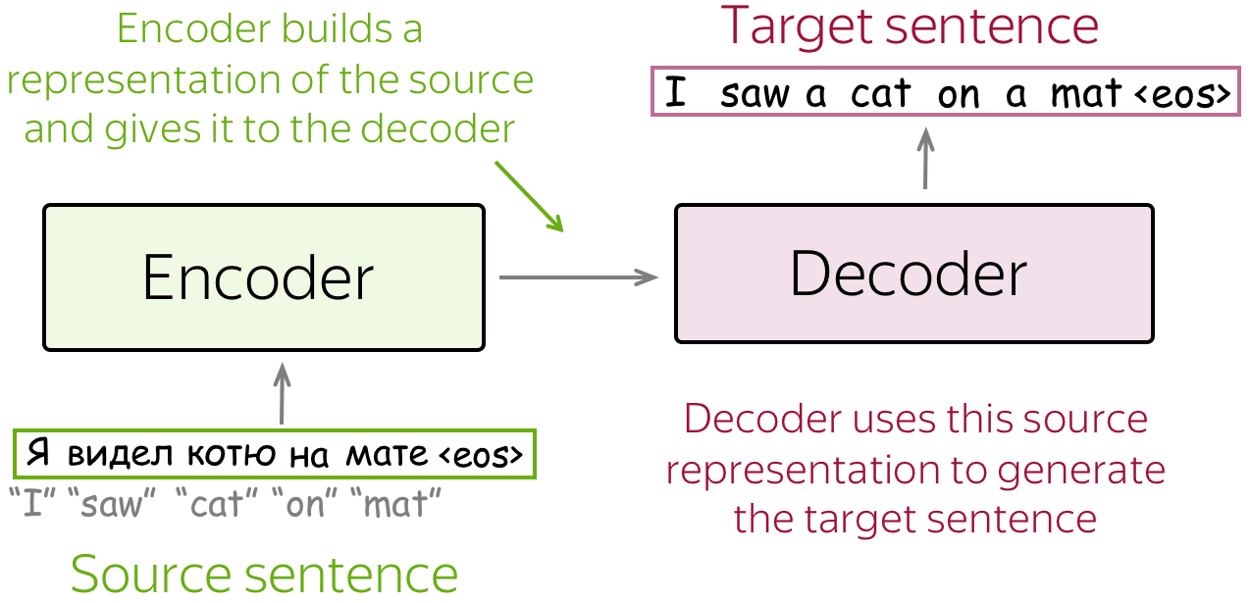
Seq2seq: Encoder-Decoder architecture
Notes:
https://lena-voita.github.io/nlp_course/seq2seq_and_attention.html
Input or source sentence, output or target sentence
An encoder: creates a representation of the input
A decoder: generates output using that representation
The encoder network “listens,” processes all input tokens, and encodes them. The decoder network “speaks,” generating the output tokens one by one.

Slide 18
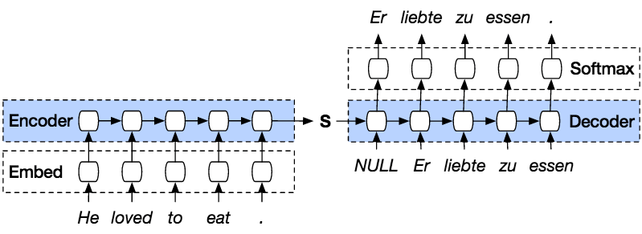
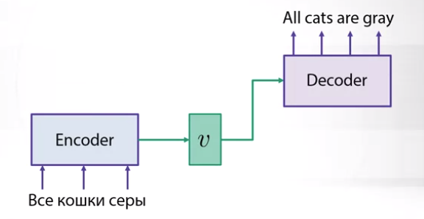
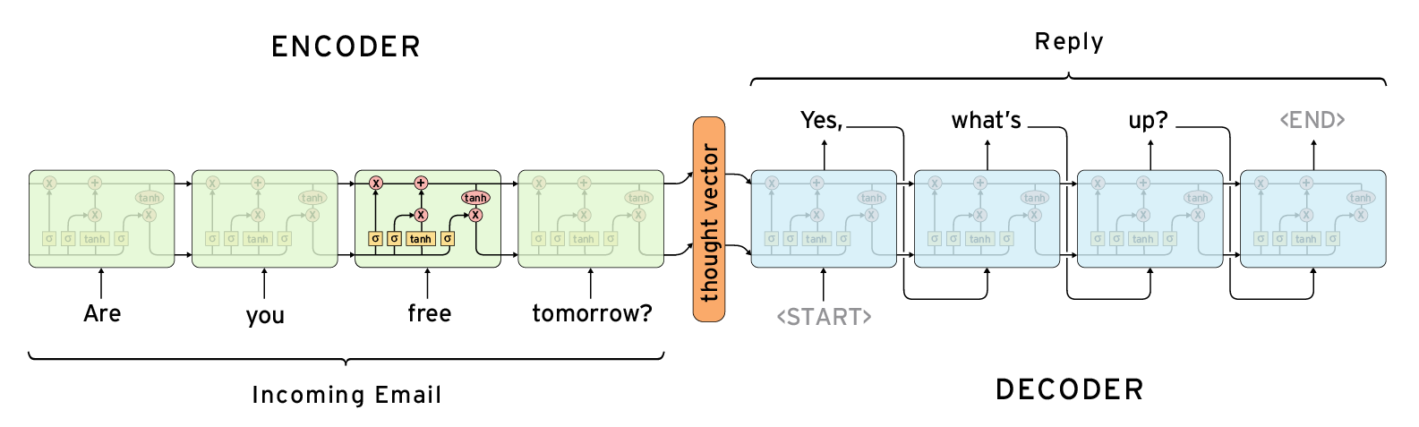
Seq2seq: Encoder-Decoder architecture
The encoder creates a meaning representation of the input sequence through the final hidden state which is called the context vector
The decoder uses the context vector as the initial decoder hidden state and a special start token to generate the target sequence
Notes:
The final hidden (and cell) state is a summary of all previous tokens.
In Seq2Seq, this summary is handed over to a second RNN where it becomes the initial state from which the decoder begins generation.
V, s, thought vector: context vector in these examples
Translation is the most classic and widely used example of a Seq2Seq task. It is also the NLP downstream task that has historically driven—and continues to drive—much of the research and innovation in Seq2Seq and attention-based models.

Slide 19
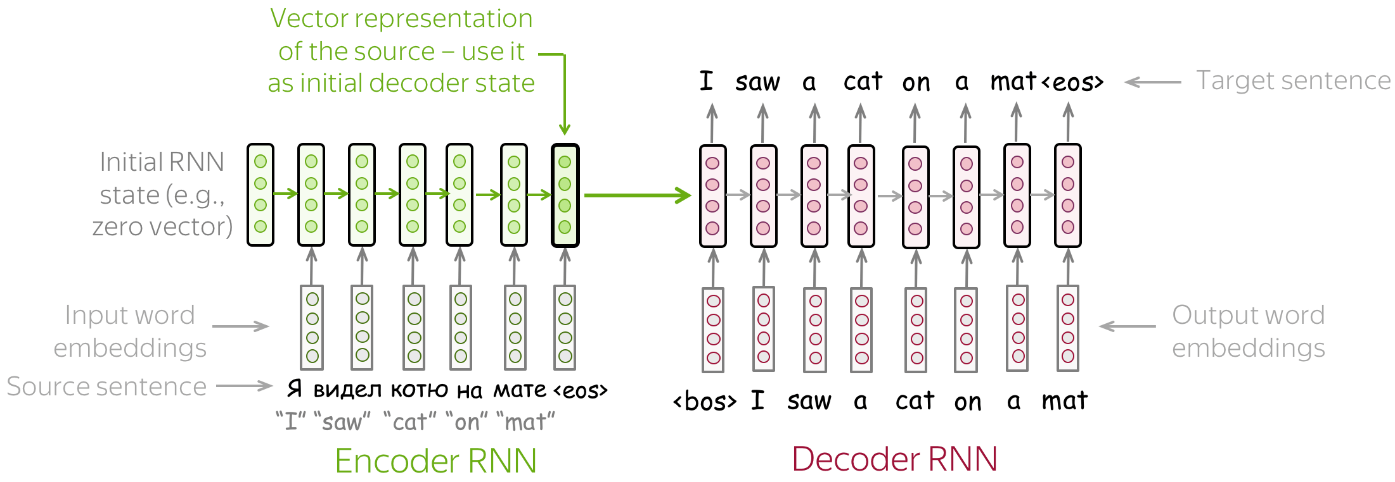
Seq2seq: RNN Encoder & RNN Decoder
Notes:
The final hidden (and cell) state is a summary of all previous tokens.
In Seq2Seq, this summary is handed over to a second RNN where it becomes the initial state from which the decoder begins generation.
An encoder: creates a representation of the input
A decoder: generates output using that representation
A way to connect them (initially a hidden state)
One network “listens,” processes all input tokens, and encodes them. Another network “speaks,” generating the output tokens one by one.

Slide 20
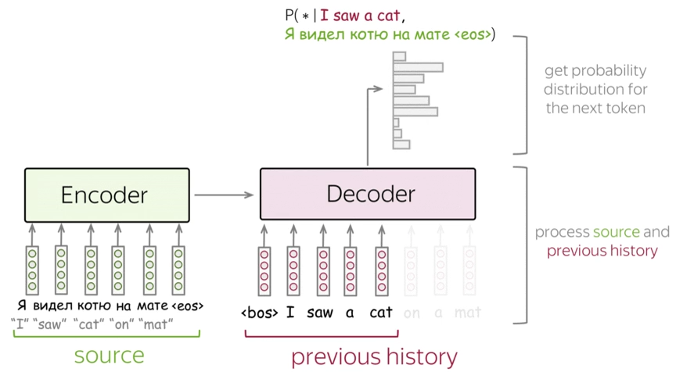
Seq2seq: RNN Encoder & RNN Decoder
Notes:
Encoder and decoder are sequential Encoder sequential is downside, because we have the full source sentence available.

Slide 21
Seq2seq: From RNN to BRNN Encoder
A standard RNN encoder processes the input left to right, updating its hidden state at each timestep
This causes the final hidden state to represent later words more strongly, while early words are partially forgotten
To balance this, we use two RNNs: one reads the sequence forward, the other backward
Both RNNs learn the same kind of computation but operate in opposite directions with separate parameters
The result is a Bidirectional RNN encoder
By concatenating the final hidden states of the forward and backward RNNs, we obtain a context vector that captures both past and future context
Notes:
Issue in longer sequence lengths
The fixed-length vector representation of the input sequence should capture all linguistic features and the full meaning of the sentence, without over-representing later words at the expense of earlier ones. However, an RNN encoder that processes a sentence from left to right updates its hidden state at each timestep, naturally retaining more information about later words while gradually forgetting earlier ones. This gives later words an unfair advantage in the final representation.
A solution is to use two RNNs: one that reads the sentence from left to right to capture later-word information, and another that reads it from right to left to capture early-word information. Each RNN performs the same type of computation, but in the opposite direction and with its own set of weights.
When we combine these two RNNs, we obtain a Bidirectional RNN (BRNN). A BRNN captures both past and future context—information from before and after each word—which are both essential for understanding meaning. We then form a richer fixed-length representation by concatenating the final hidden states of the forward and backward RNNs.

Slide 22
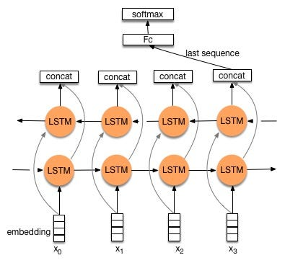
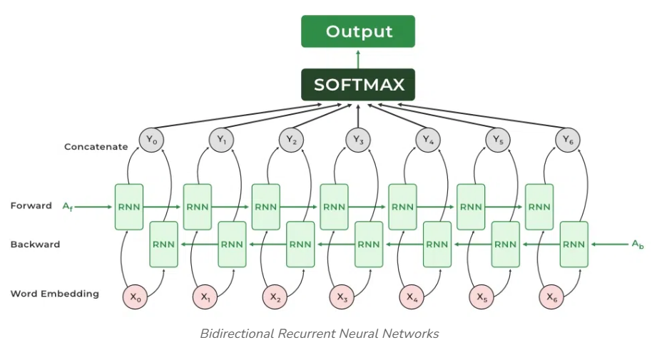
Seq2seq: From RNN to BRNN Encoder
Notes:
https://www.geeksforgeeks.org/deep-learning/bidirectional-rnns-in-nlp/
Issue in longer sequence lengths
The fixed-length vector representation of the input sequence should capture all linguistic features and the full meaning of the sentence, without over-representing later words at the expense of earlier ones. However, an RNN encoder that processes a sentence from left to right updates its hidden state at each timestep, naturally retaining more information about later words while gradually forgetting earlier ones. This gives later words an unfair advantage in the final representation.
A solution is to use two RNNs: one that reads the sentence from left to right to capture later-word information, and another that reads it from right to left to capture early-word information. Each RNN performs the same type of computation, but in the opposite direction and with its own set of weights.
When we combine these two RNNs, we obtain a Bidirectional RNN (BRNN). A BRNN captures both past and future context—information from before and after each word—which are both essential for understanding meaning. We then form a richer fixed-length representation by concatenating the final hidden states of the forward and backward RNNs.

Slide 23
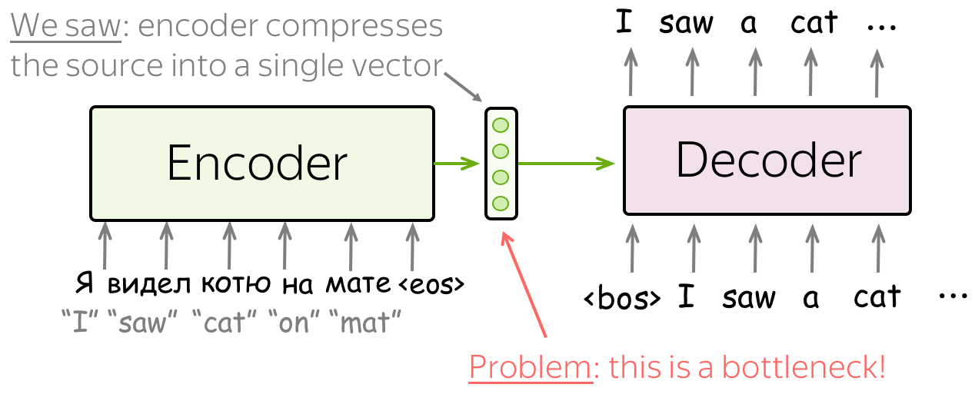
Seq2seq: Bottleneck
The final hidden state of the encoder tries to compress the whole input sentence into one fixed-length context vector
When dealing with long sentences we lose information resulting in an information bottleneck
Notes:
The final hidden state tries to compress the whole input sentence into one vector → too small
Long sentences lose information → translations (or summaries, answers, …) become inaccurate
Even LSTMs struggle with this compression
Issue of both RNN and BRNN encoder
Furthermore, the output sequence depends heavily on the hidden state of the final RNN cell of the encoder. The encoder’s state is only passed to the first RNN cell of the decoder and with every time step information from the encoder disappears such that later timesteps have much less access to the encoder information. This makes it also difficult for the model to deal with long sequences.

Slide 24
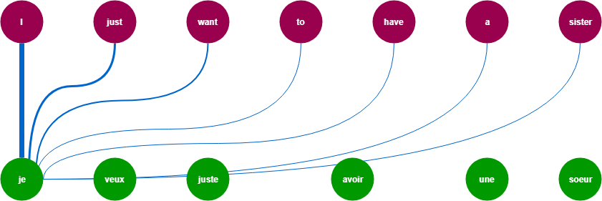
Seq2Seq: Attention
How do humans translate a source sentence into a target sentence?
By focusing on the specific word (or words) they are translating at each moment
Notes:
https://medium.com/what-is-artificial-intelligence/introduction-to-transformer-networks-how-google-translate-works-attention-is-all-you-need-309827c9b942

Slide 25
Seq2seq: Attention
To fix the information bottleneck in seq2seq, we drew inspiration from human attention
Humans focus on the specific word they are translating at each moment
Attention means selectively concentrating on key information while ignoring the rest
In seq2seq with attention, the decoder can look at all encoder hidden states at every timestep
The model learns an attention distribution that indicates how strongly to focus on each input token
Notes:
To address the information bottleneck problem in Seq2Seq models, we took inspiration from human behavior. When humans translate a sentence, they don’t rely on a single memory of the whole sentence—they focus on the specific word or phrase they are translating at that moment. This is attention: the cognitive process of selectively concentrating on certain information while ignoring the rest.
We replicate this mechanism in Seq2Seq networks. At each decoding step, the decoder can attend to all encoder hidden states and decide which parts of the input are most relevant. During training, the model learns how strongly to focus on each encoder state, resulting in an attention distribution that varies across timesteps.
This mechanism improves performance on many seq2seq tasks, such as summarization, dialogue, question answering, and more — not just translation.

Slide 26
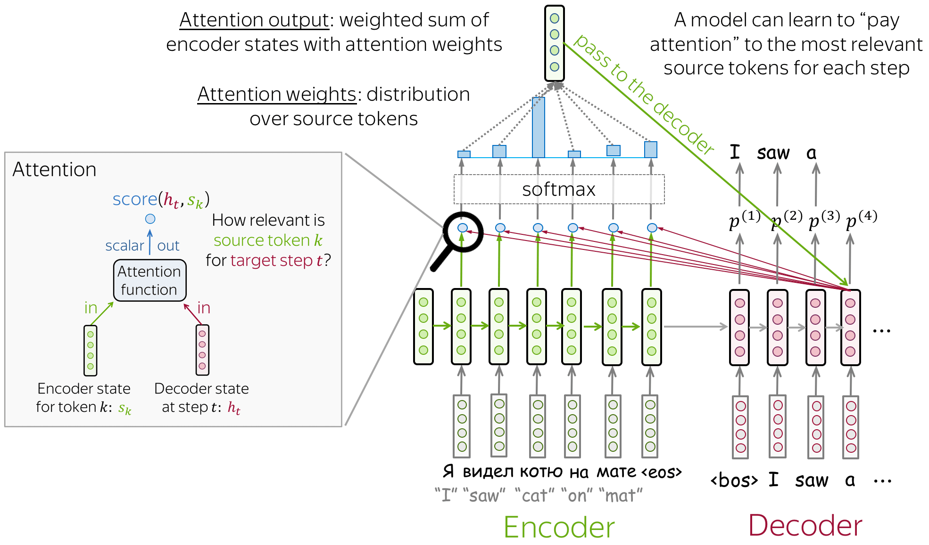
Seq2seq: Attention
Notes:
Attention function = how we compute attention scores.
You can apply any function you want. Function measures how related or similar the words are.
The most popular ways to compute attention scores are:
dot-product - the simplest method;
bilinear function (aka "Luong attention") multi-layer perceptron (aka "Bahdanau attention")

Slide 27
Seq2seq: Attention
Without attention: the decoder receives only the final encoder hidden state as the context vector
This compresses all input information into one fixed-length context vector resulting in an information bottleneck
With attention: the decoder has access to all encoder hidden states
At each timestep, it computes a new context vector focused on the most relevant parts of the input
This allows dynamic, flexible use of input information and improves performance on long or complex sequences
Notes:
In a Seq2Seq model without attention, the decoder receives only the final hidden state of the encoder as its context vector. This forces the entire meaning of the input sequence into a single fixed-length vector, creating an information bottleneck—especially for long or complex sentences.
With attention, the decoder is no longer limited to the final hidden state. Instead, it has access to all encoder hidden states and computes a new context vector at each decoding timestep. This context vector highlights the encoder states that are most relevant for predicting the next output word, allowing the model to focus dynamically on different parts of the input sequence.
Attention helps the decoder focus on the relevant parts of the input sequence, even if those words appear far apart.

Slide 28
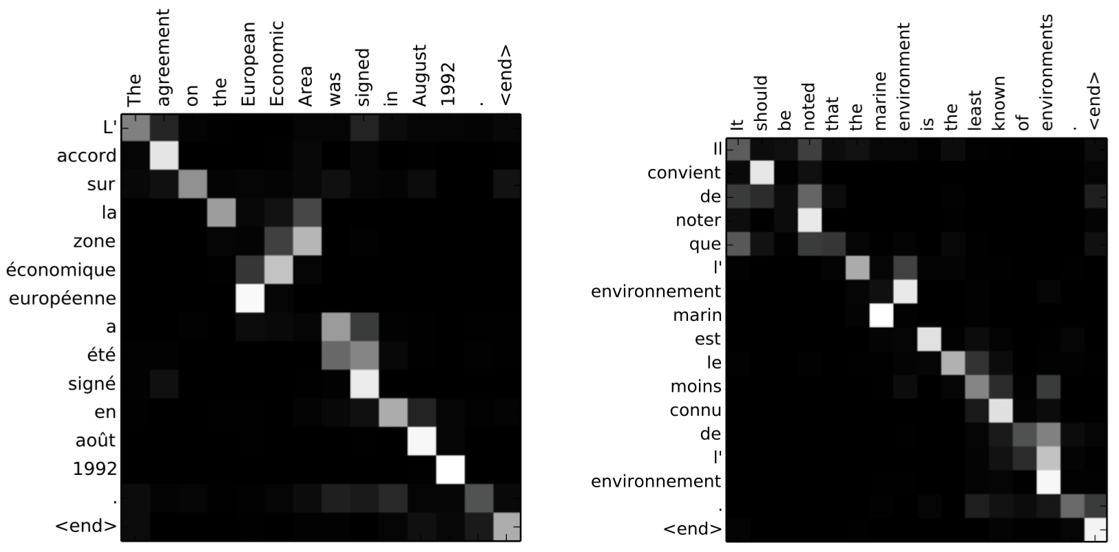
Seq2seq: Attention learns alignment between words of different sequences
Notes:
Remember the motivation for attention? At different steps, the decoder may need to focus on different source tokens, the ones which are more relevant at this step. Let's look at attention weights - which source words does the decoder use?

Slide 29
Seq2seq: Limitations
Sequential processing: Must read tokens one by one, making training and inference slow and impossible to parallelize
Long-distance dependencies: Even with attention, the encoder’s hidden states weaken over long sequences, limiting the model’s ability to capture long-range relationships
Limited context window: each encoder hidden state represents only a small, local portion of the input so information from earlier parts of long sequences becomes weakened
Attention computation: Requires comparing each decoder step to all encoder states which becomes costly for long sequences
Notes:
Sequential Processing
Seq2Seq with attention still relies on RNNs, which process tokens one by one, making training and inference slow and impossible to parallelize.
Long-Distance Dependencies
Attention helps the decoder focus on the relevant parts of the input sequence, even if those words appear far apart.
Even with attention, the encoder’s RNN hidden states weaken over long sequences, limiting the model’s ability to capture long-range relationships.
Limited Context Window
In Seq2Seq with attention, the encoder still produces a sequence of hidden states from an RNN, and each hidden state summarizes only the nearby words it has recently processed; as the sequence grows longer, earlier information becomes weakened across many timesteps, making it hard for the model to represent and use very long inputs effectively.
Attention Computation
Attention requires comparing each decoder step to all encoder states, introducing expensive O(input × output) computation that becomes costly for long sequences.

Slide 30
Transformers The power of self-attention

Slide 31
From Seq2seq with Attention to Transformers
Seq2seq with attention greatly improved translation and other seq2seq tasks by allowing the decoder to focus on relevant parts of the input
However, these models still rely on RNNs, which process tokens sequentially, struggle with very long inputs, and cannot be efficiently parallelized
Attention introduced a powerful idea: directly linking any target token to any source token, which proved far more powerful than the recurrent structure around it
The transformer architecture takes this insight further by removing recurrence entirely and relying solely on attention mechanisms
This shift enables parallel processing, better long-range modeling, and significantly larger models, laying the foundation for modern LLMs
Notes:
The transformer architecture takes this insight further : we can use it to also link token within the same sequence
Originally proposed for seq2seq, later used for LLMs as well

Slide 32
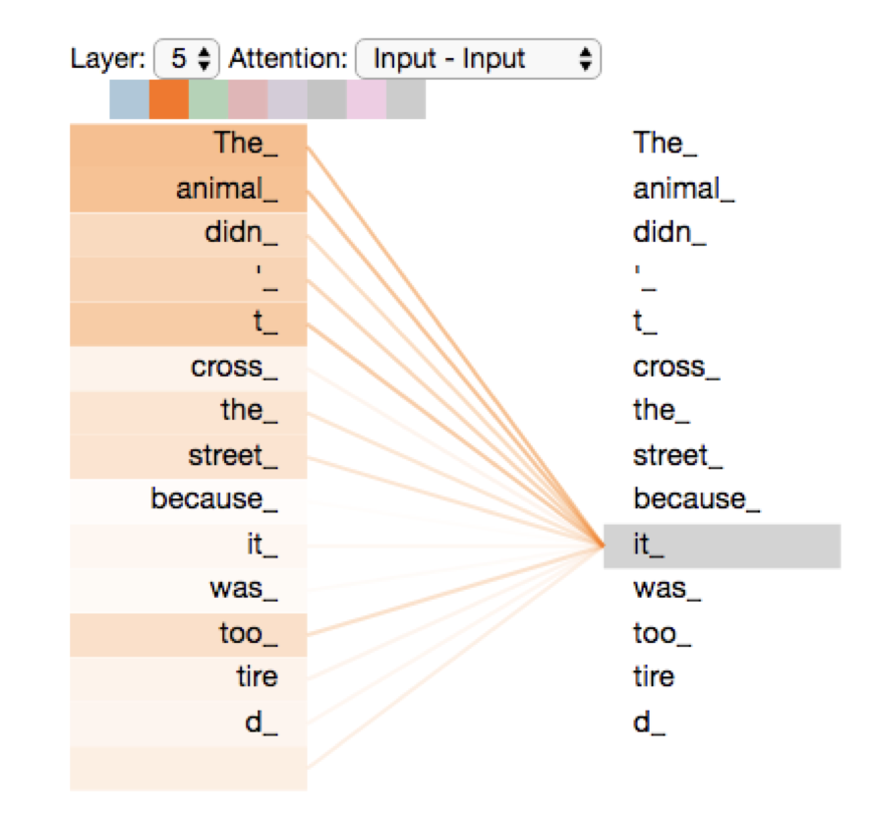
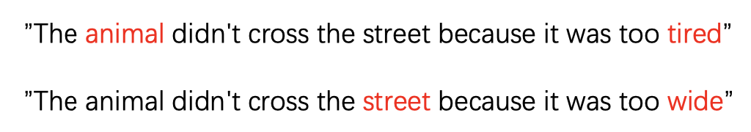
Self-Attention
Self-attention allows each token in a sequence to look at all other tokens in the same sequence to decide which ones are most relevant for understanding its meaning
Instead of passing information step by step like in an LSTM, self-attention connects every token directly to every other token in a single operation
Notes:
Difference with attention in seq2seq: not between tokens of two sequences but between tokens of the same sequence

Slide 33
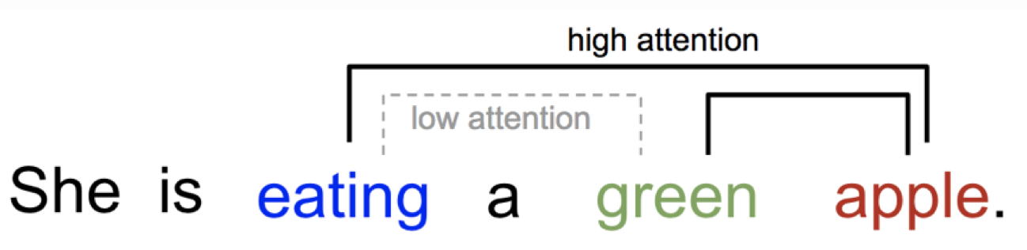
Self-Attention
Each token asks: “Which other words matter to me?”
It assigns attention weights (higher for more relevant words)
The token’s new embedding becomes a weighted combination of all the words it attends to
Each token’s new embedding now encodes both syntactic and semantic relations
Notes:
Captures long-range syntax (e.g., subject–verb agreement) and semantic relations (e.g., coreference).

Slide 34
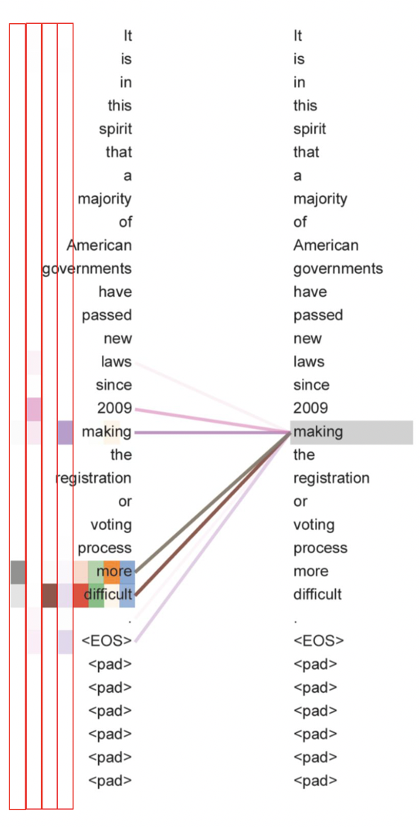
Multi-Head Self-Attention
A single self-attention operation can capture only one type of relationship between words
To learn multiple complementary relationships the model applies self-attention multiple times in parallel
Each parallel attention operation is called a head, and together they form multi-head self-attention, allowing the model to look at the input from different perspectives at once
Notes:
Usually, self-attention is performed multiple times to learn multiple interesting relations between words. We call this multi-head self attention.
Here, each column shows the attention distribution of a different head.
One head may track syntax (which word modifies which)
Another head may track coreference (“he” → “John”)
Another head may track topic or semantic similarity
Another head may track timing
Thus, each head is like a specialist.

Slide 35
Multi-Head Self-Attention
Multi-head self-attention is applied across many layers of a transformer, with each head and layer capturing different aspects of language
Lower layers: Learn local linguistic features such as basic morphology and part-of-speech cues
Middle layers: Integrate information from multiple heads to capture syntactic structures, phrase boundaries, and short-range dependencies
Higher layers: Learn global, abstract features, including context-dependent word meaning, long-range relationships, and semantic or conceptual patterns
This layered, multi-head architecture allows to build a hierarchical understanding of language
Notes:
Examples of Linguistic Features Learned by Transformer Layers
1. Basic Morphology (Lower Layers)
Recognizing suffixes and prefixes:
“running” → “run” + “-ing”
“unhappy” → “un-” + “happy”
Plural forms: “cats”, “boxes”
Verb conjugations: “walk”, “walks”, “walked”, “walking”
Comparative forms: “big”, “bigger”, “biggest”
2. Part-of-Speech Cues (Lower Layers)
Identifying nouns vs. verbs:
“run” (noun) vs. “run” (verb)
Detecting adjectives vs. adverbs:
“quick” vs. “quickly”
Recognizing auxiliaries: “is”, “have”, “will”
Spotting determiners: “the”, “a”, “this”
3. Syntactic Structures (Middle Layers)
Subject–verb–object structure:
“The dog chased the ball.”
Identifying the main verb in a sentence
Detecting clauses:
“Although it rained, we went outside.”
Question structure:
“What did you see?”
4. Phrase Boundaries (Middle Layers)
Noun phrase detection:
“the small red car”
Verb phrase detection:
“is running quickly”
Prepositional phrase boundaries:
“on the table”, “under the bridge”
Multi-word expressions:
“in front of”, “once upon a time”
5. Short-Range Dependencies (Middle Layers)
Agreement between nearby words:
“She is happy” (not “are”)
Local modifications:
“very cold”, “extremely fast”
Negation scope:
“not really good”
Adjective–noun pairings:
“red apple”, “big house”
6. Long-Range Relationships (Higher Layers)
Subject–verb agreement across distance:
“The bouquet of roses was beautiful.”
Coreference:
“John went home because he was tired.”
Tracking entities across sentences
Handling nested clauses:
“The book that you gave me that you bought last week was great.”
7. Semantic or Conceptual Patterns (Higher Layers)
Word sense disambiguation:
“bank” (river) vs. “bank” (finance)
Recognizing metaphors:
“She has a heart of stone.”
Topic detection:
Recognizing text about climate change vs. economics
Causal reasoning:
“It rained, so the match was canceled.”

Slide 36
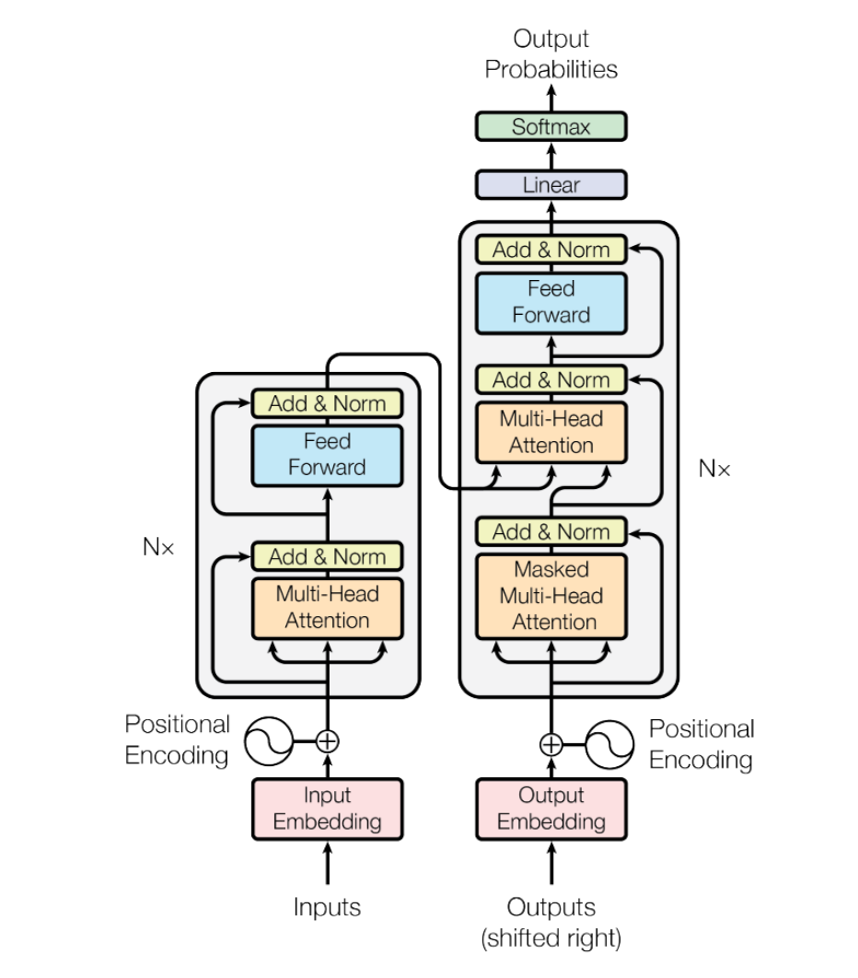

Transformer Architecture Encoder-Decoder model, multiple layers
A Transformer is an encoder–decoder architecture built from multi-head attention layers and feedforward layers
Notes:
For seq2seq tasks
Left: N encoder blocks, right: N decoder blocks Layers: attention and feedforward

Slide 37



Transformer Architecture Encoder-Decoder model, multiple layers
Notes:
https://jalammar.github.io/illustrated-transformer/

Slide 38
Transformer Architecture Input and output embeddings
The inputs are the embeddings of the tokens in the source sequence
The outputs are the embeddings of the generated tokens in the target sequence, obtained by sampling from the output probability distribution at each decoding step
To keep information about the sequence order, this information is added to the token embeddings through positional encoding
Notes:
Attention mechanisms do not inherently take into account sequence order
RNN-based architectures positional encoding is not necessary because the RNNs learn to add information about the sequence order automatically,
but we need this in a transformer for parallel processing

Slide 39
Transformer Architecture Encoder
The encoder consists of multiple encoder blocks. Each block consists of multi-head self-attention layers followed by add and norm layer, and feed forward layers followed by add and norm layer
The encoder takes the input sequence and outputs contextualized input word representations
Notes:
The self-attention learns representations for words that capture the meaning of these words by looking at the relations of this words in the sentence. We call this self-attention, because it is attention within the same sequence.
Multi-head attention because attention is applied multiple times in the same layer to learn multiple relationships of the words at once. Why three input? See next slide
The feedforward layers refine word representations using learned linguistic knowledge
Add and norm help training (more later slide)
Add layer: residual connection which preserves original information and helps deep networks train
Norm layer: layer normalization which stabilizes activations and improves training efficiency

Slide 40
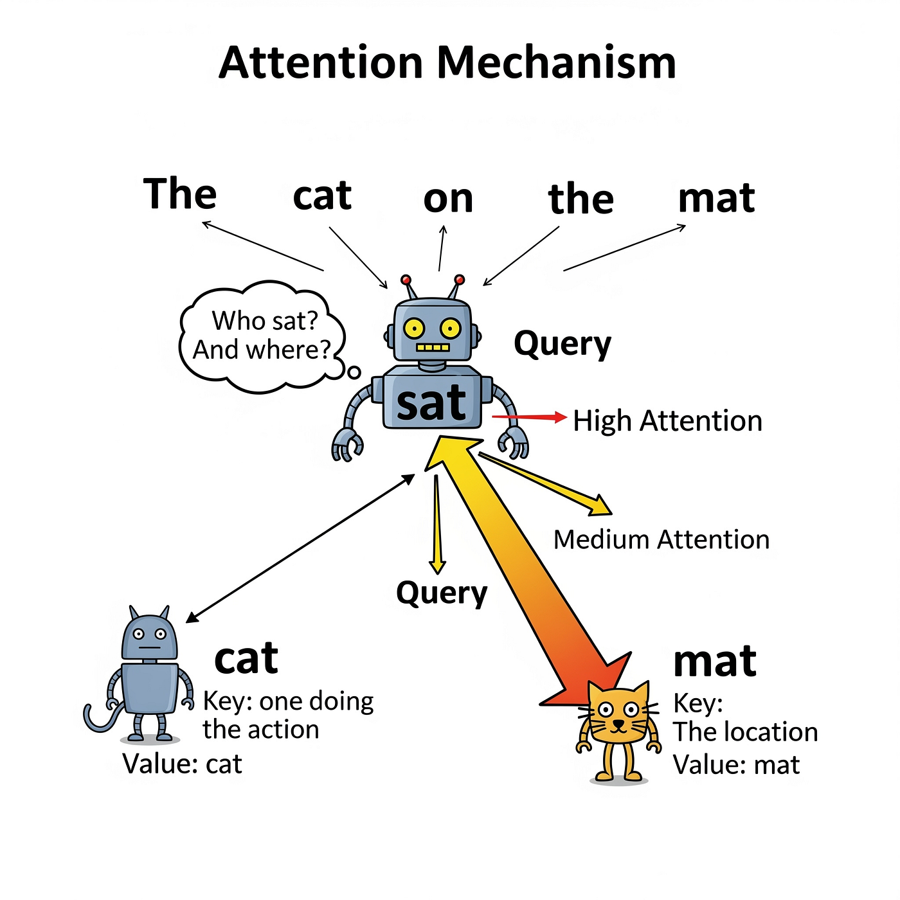
Self-attention Query, Key and Value
Every token embedding is transformed into three embeddings:
Query: represents what information this word is looking for
Key: represents what information this word contains
Value: represents the actual content that is passed to other words when they attend to it
Notes:
https://medium.com/@anagharamdas2000/a-beginners-guide-to-the-logic-of-transformers-powering-modern-ai-e21be8b02286
Think of it like this:
Query = question
Key = label
Value = information

Slide 41
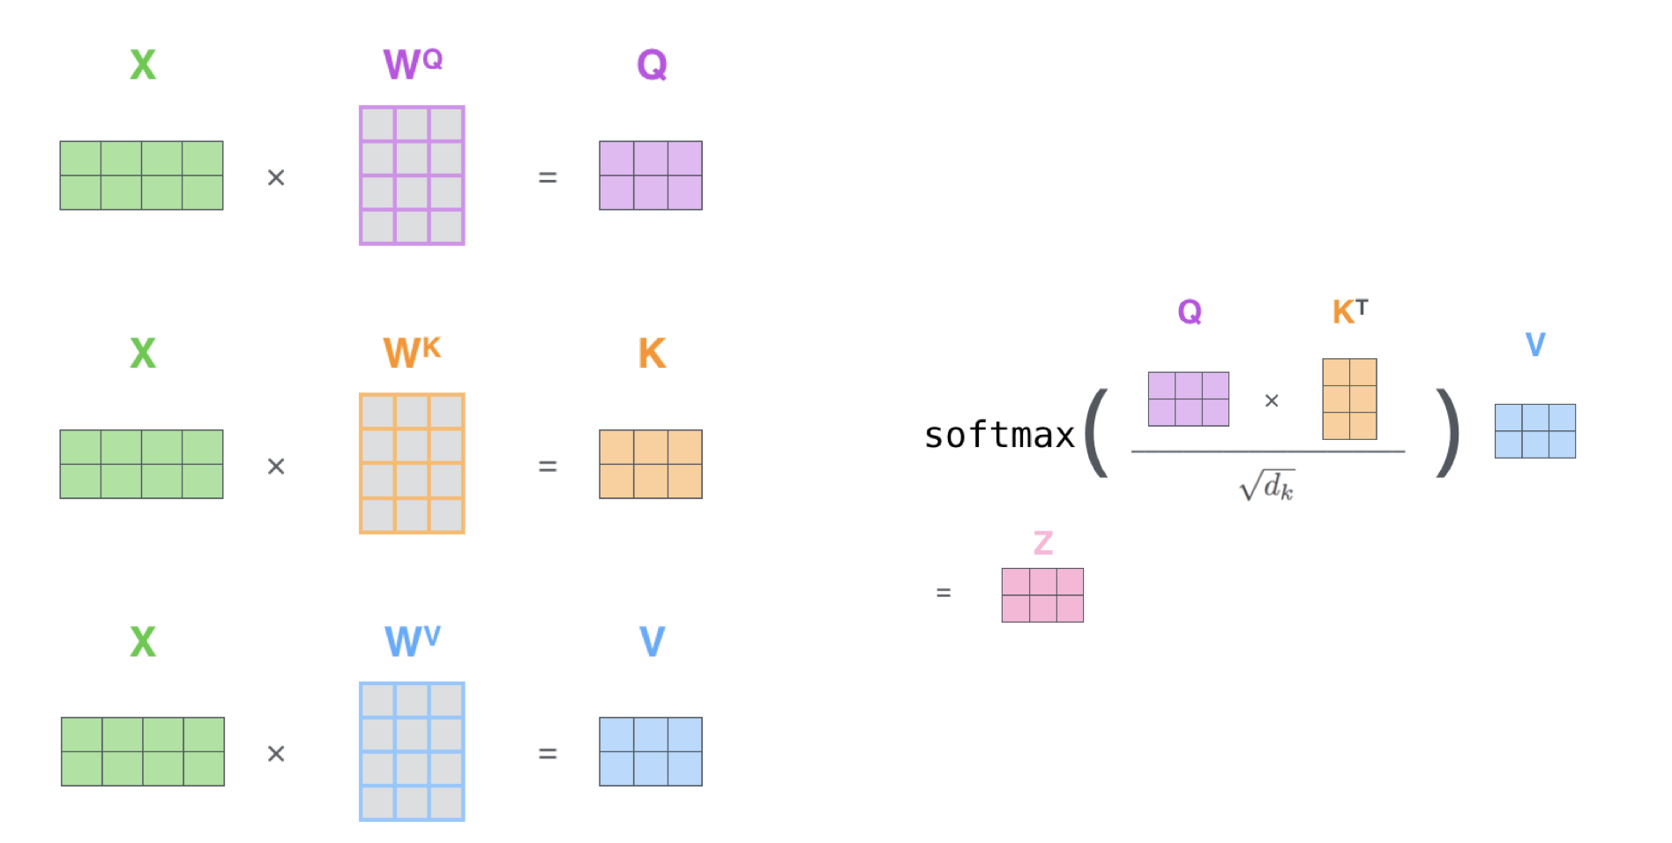
Self-attention Query, Key and Value
Every token embedding is transformed into three embeddings:
Query: represents what information this word is looking for
Key: represents what information this word contains Value: represents the actual content that is passed to other words when they attend to it
Next, all words compute their own contextualized representations simultaneously by multiplications
First, sentence X (e.g., black cat or she eats) is projected to Query space, Key space and Value space
Notes:
Attention weights obtained based on scaled dot product and then softmax
The token’s new embedding becomes a weighted combination of all the words it attends to
1. Every word is transformed into three vectors: a Query, a Key, and a Value.
Query: represents what this word is looking for — what kind of information it needs.
Key: represents what this word contains — what kind of information it offers.
Value: represents the actual content that can be passed to other words when they attend to it.
Think of it like this:
Query = question
Key = label
Value = information
2. How attention works (conceptually)
Step 1: A word asks a question (Query).
Example: in the sentence “The cat sat on the mat”, the word “sat” asks: Who is doing the sitting?
This is its query.
Step 2: All words provide labels that say what they are.
Each word emits its key, which might conceptually represent:
“cat” → I’m an animal / subject
“sat” → I’m a verb
“mat” → I’m an object
Step 3: The query compares itself with each key.
The model checks:
How well does this word’s question (Query) match each other word’s label (Key)?
If the query “Who is sitting?” matches the key of “cat”, the model discovers:
“cat is relevant to sat.”
This determines attention weights.
Step 4: The word collects the relevant information (Values).
Once the model knows which words are relevant, it pulls in their values. The value contains the information that contributes to meaning — not just the label.
So “sat” gathers the value from “cat,” creating a richer contextual representation.

Slide 42
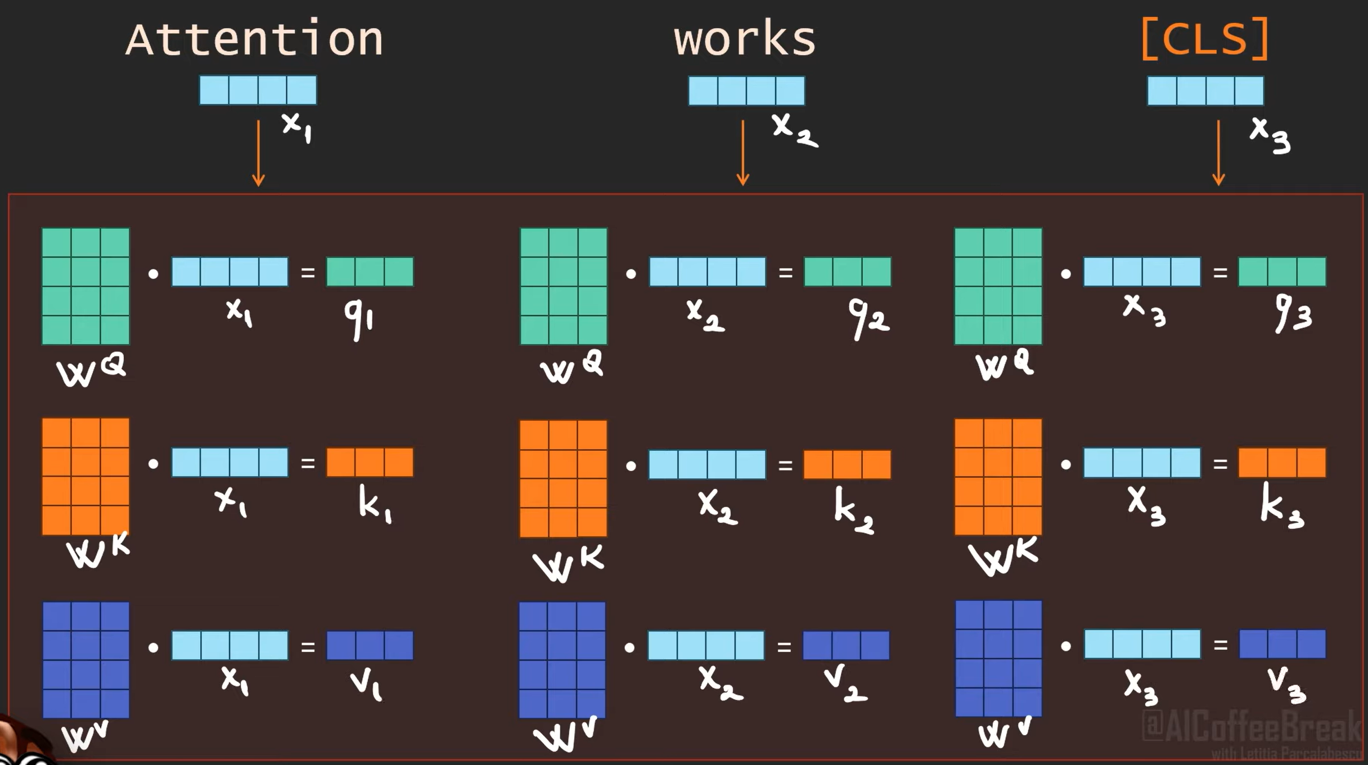
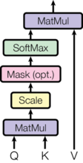
Self-attention Query, Key and Value
Notes:
https://www.youtube.com/watch?v=FWFA4DGuzSc&t=18s&ab_channel=AICoffeeBreakwithLetitia

Slide 43
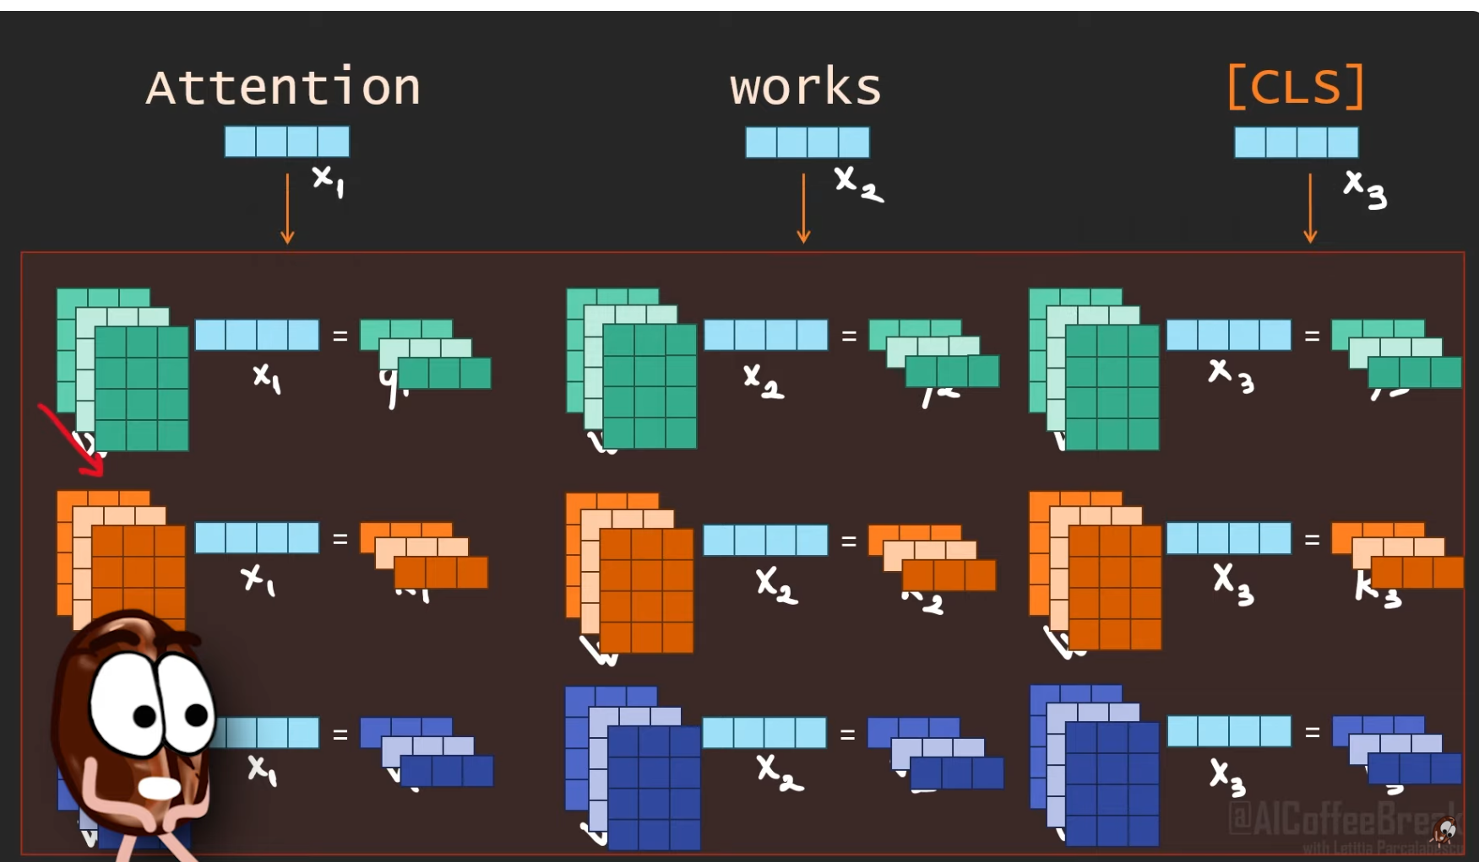
Multi-head Self-attention Query, Key and Value
Notes:
https://www.youtube.com/watch?v=FWFA4DGuzSc&t=18s&ab_channel=AICoffeeBreakwithLetitia

Slide 44
Transformer Architecture Decoder
The decoder also consists of multiple decoder blocks. Each decoder block is similar to the encoder block but uses masked self-attention and an extra attention step where it calculates cross-attention between the encoder tokens (i.e., the output of the final encoder block) and already predicted decoder tokens
The decoder generates the target sequence token by token conditioned on the previously generated tokens and the tokens in the source sequence
Notes:
The self-attention learns representations for words that capture the meaning of these words by looking at the relations of this words in the output sequence.
Masked because in transformer we input the input and output sequence all at once. We generate words at each timestep and when predicting the word we can only look at previous timesteps not future timesteps otherwise we do not learn anything
Next to that, cross-attention is still applied to learn relationships between the output and input words for the language generation task at hand, e.g., translation or question answering. Each decoder block uses output of final encoder block.
Self-attention is for word representation learning and cross-attention for the task.
Multi-head attention because attention is applied multiple times in the same layer to learn multiple relationships of the words at once.
Explain how a timestep works (word probabilities outputted, then word used as input at output side to predict next word)

Slide 45
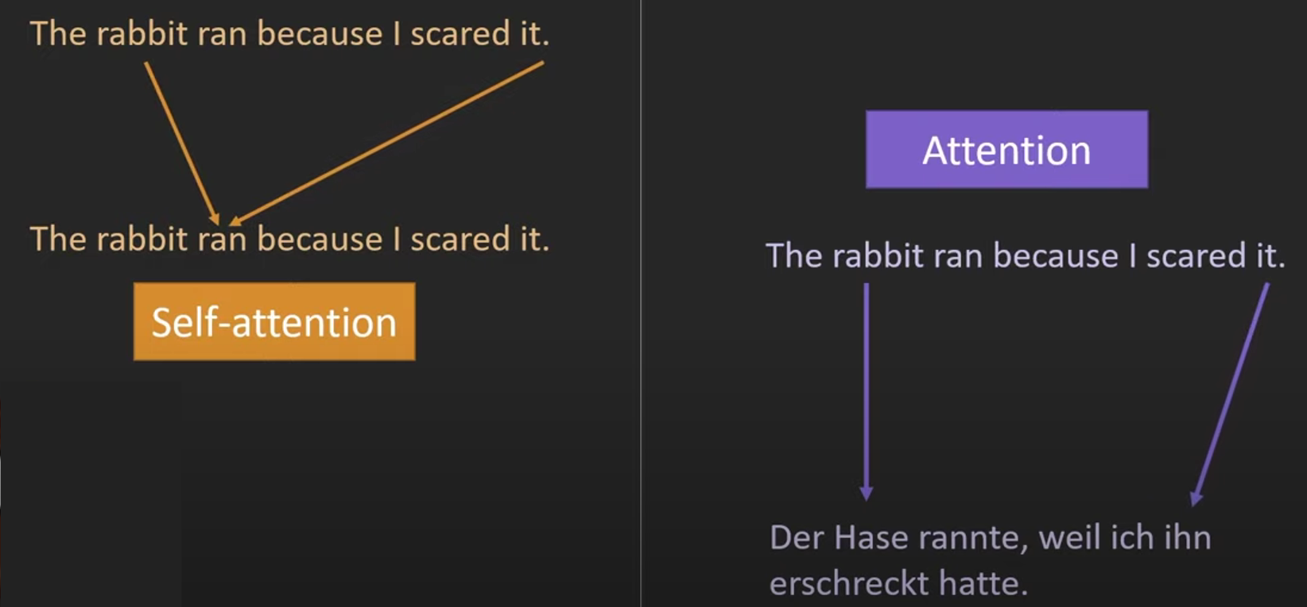

Attention Self-Attention versus Encoder-Decoder Attention
Multi-head attention
Self-attention is a mechanism in which a token attends to all other tokens in the same sequence to learn contextual relationships (representation learning)
In the encoder, self-attention learns relationships between source tokens, producing contextualized input representations
In the decoder, self-attention learns relationships between previously generated target tokens, but it is masked to prevent the model from seeing future tokens, ensuring the decoder generates text left-to-right
Notes:
https://www.youtube.com/watch?v=FWFA4DGuzSc&t=18s&ab_channel=AICoffeeBreakwithLetitia

Slide 46
Attention Self-Attention versus Encoder-Decoder Attention
Multi-head attention
Encoder-decoder attention or cross-attention is a mechanism used only in the decoder, where each target token attends to the encoder’s output representations
This allows the decoder to focus on the most relevant parts of the source sequence when predicting each target word, enabling the model to learn the mapping from input to output (task learning)
Notes:
https://www.youtube.com/watch?v=FWFA4DGuzSc&t=18s&ab_channel=AICoffeeBreakwithLetitia

Slide 47
Transformer Architecture Output
At each step, the decoder predicts the most likely next word of the output sequence by outputting a probability distribution over the tokens in the vocabulary and sampling from this distribution
Notes:
The self-attention learns representations for words that capture the meaning of these words by looking at the relations of this words in the sentence. Within the output sequence.
Masked because in transformer we input the input and output sequence all at once. We generate words at each timestep and when predicting the word we can only look at previous timesteps not future timesteps otherwise we do not learn anything
Next to that, cross-attention is still applied to learn relationships between the output and input words for the language generation task at hand, e.g., translation or question answering. Each decoder block uses output of final encoder block.
Self-attention is for word representation learning and cross-attention for the task.
Multi-head attention because attention is applied multiple times in the same layer to learn multiple relationships of the words at once.
Explain how a timestep works (word probabilities outputted, then word used as input at output side to predict next word)
Sample from output probability

Slide 48


Slide 49


Slide 50
Transformer Architecture Skip connections
Skip connections are used to obtain a good balance between learning new information and remembering old information
They are necessary to properly train deep neural architectures
Notes:
Without the skip connections deep neural architectures suffer from the vanishing gradient problem, which means the training signal gets lost during back propagation.
Add: residual connection → preserves original information and helps deep networks train.
Norm: layer normalization → stabilizes activations and improves training efficiency.

Slide 51
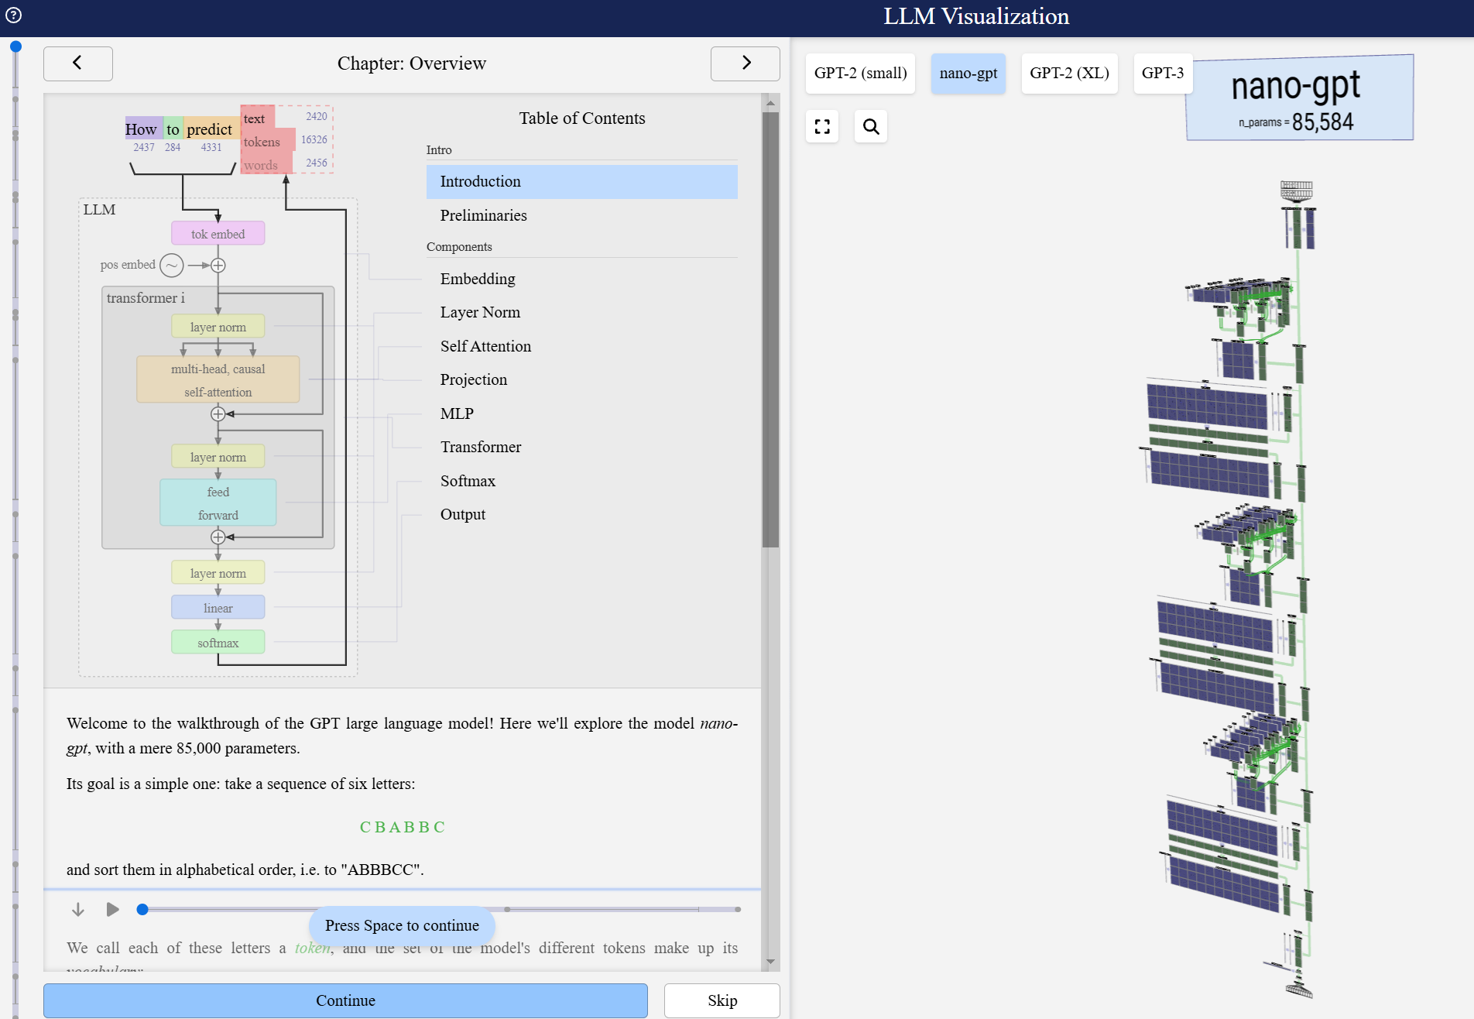
Detailed breakdown: https://bbycroft.net/llm

Slide 52
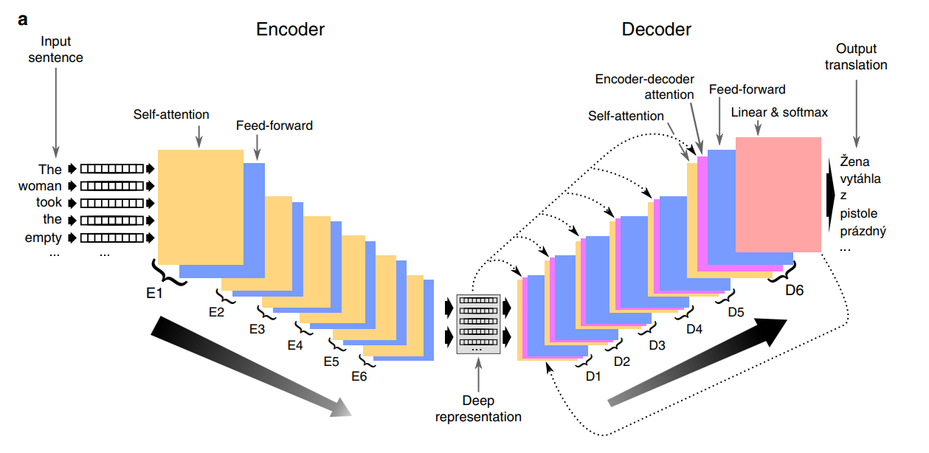
Transformer for Machine Translation
Notes:
Can be used for question answering as well

Slide 53
Transformer Architecture: Summary
Transformer is an encoder-decoder architecture for seq2seq tasks that no longer uses recurrent layers
The encoder and decoder only use attention and feedforward layers:
Self-attention operates between source tokens (in the encoder) or between target tokens (in the decoder) to capture context and meaning for representation learning
Feedforward layers process each token’s updated representation independently, applying linear transformations and non-linear activations to refine and update its meaning using the model’s learned general linguistic knowledge
Cross-attention operates between each target token and all source tokens to align input and output sequences for task learning
Has accelerated the field of natural language processing in tackling human language since 2017
Notes:
Self-attention shares information across the sequence.
By combining attention with feedforward layers, the Transformer processes sequences efficiently and without recurrence in a fully parallelizable way.

Slide 54
From the Original Transformer to Modern LLMs

Slide 55
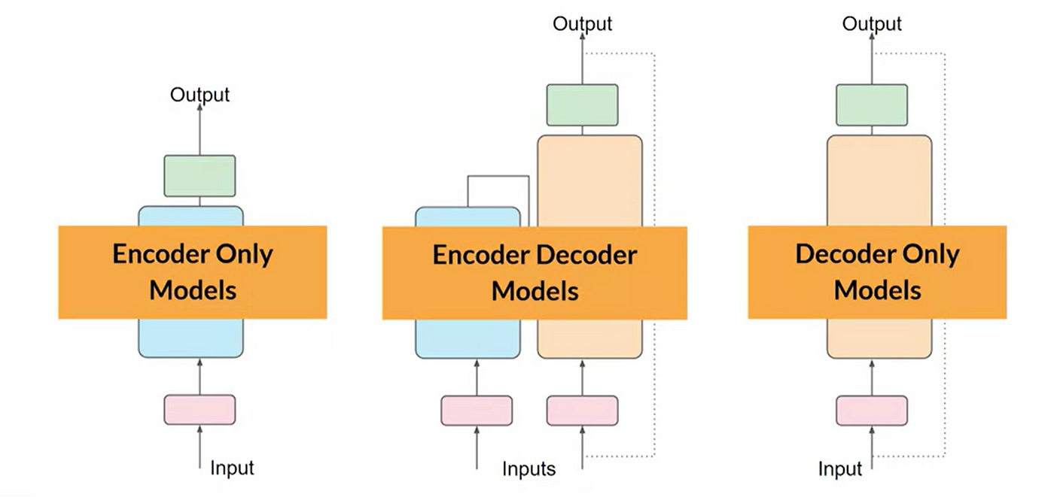
Transformer LLMs Three different types
The original Transformer was built for seq2seq tasks (like translation), using an encoder–decoder structure with self-attention and cross-attention
However not all NLP tasks require both components, leading to three main architectural variants

Slide 56
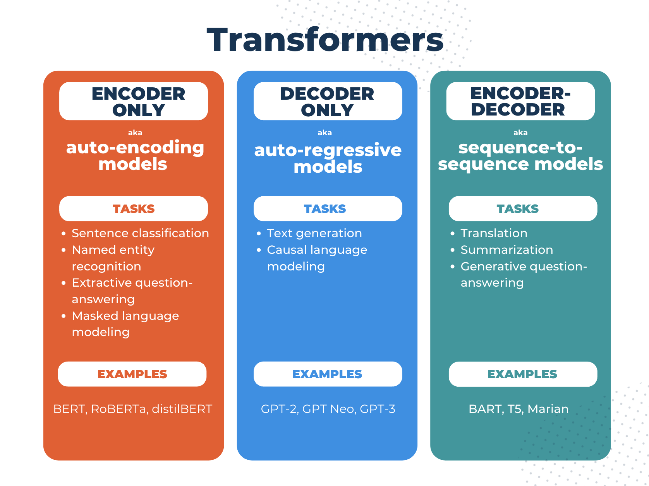
LLMs: Encoder – Decoder Models
Use both an encoder and decoder
Designed for tasks that transform one sequence into another such as translation, summarization, paraphrasing, and instruction following
Are widely used for seq2seq tasks and certain instruction-tuned LLMs
Notes:
What we have seen so far

Slide 57
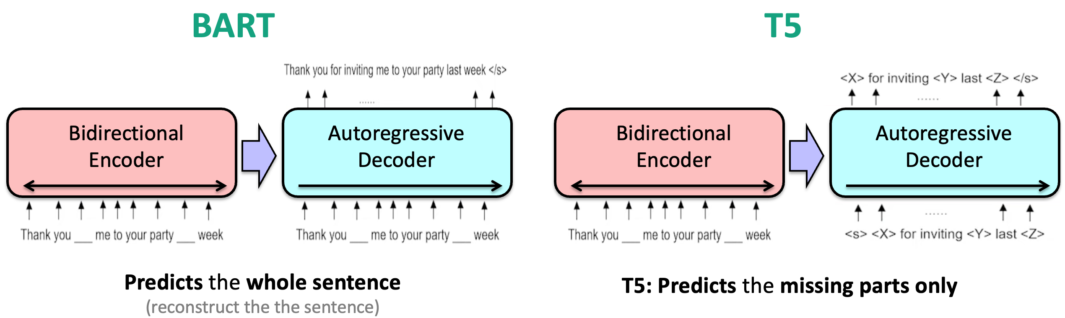
Encoder – Decoder Models
Notes:
https://medium.com/@lmpo/encoder-decoder-transformer-models-a-comprehensive-study-of-bart-and-t5-132b3f9836ed
Pre-trained encoder–decoder Transformers like BART and T5 are used as general text-to-text models: they take an input sequence, encode it into contextual representations, and then decode it into an output sequence. Because they are trained with denoising or span-corruption objectives, they learn to rewrite, transform, and generate coherent text. In practice, they are commonly fine-tuned on specific Seq2Seq tasks such as summarization, paraphrasing, question answering, and text rewriting, where the model learns to map one kind of text input into the desired text output.

Slide 58
LLMs: Encoder-Only Models
Encoder-only transformers use only the encoder with full self-attention
Produce strong contextualized embeddings
Are suited for language understanding tasks
Notes:
Output: numeric representations

Slide 59
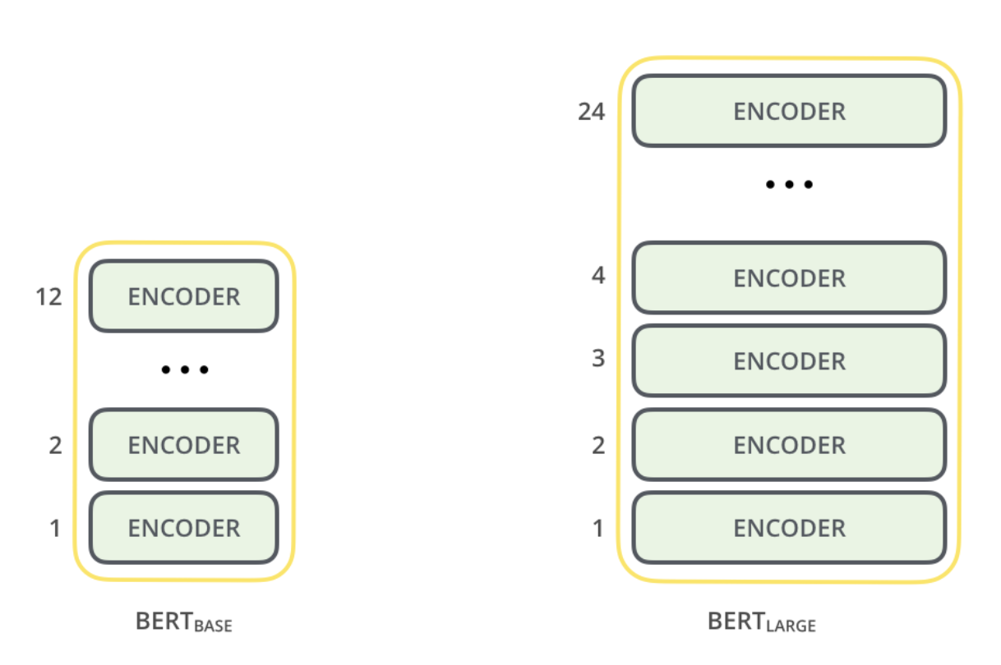

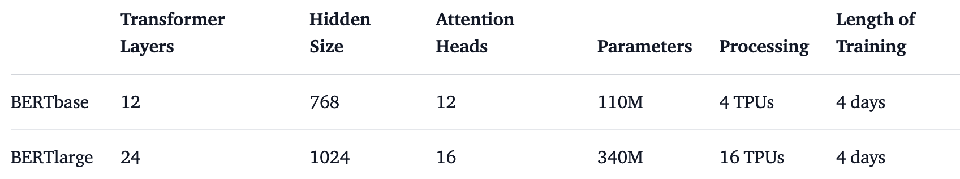
Encoder-Only: BERT Bidirectional Encoder Representations from Transformers (Google, 2018)
Notes:
GPT-3: Generative Pretrained Transformer (OpenAI, 2020)
GPT-3 is an autoregressive language model trained to predict the next word in a sequence. It is an LLM trained on vast, unannotated text corpora (Common Crawl, WebText2, Books1, Books2 and Wikipedia) Its architecture is based on the decoder block of the Transformer architecture
Uses masked self-attention so each token only attends to previous tokens
175 billion parameters: one of the largest models ever trained (at release)
Needs a lot of processing power, memory and time to train!!!
The Common Crawl dataset includes 50 billion of web pages = most of the internet

Slide 60
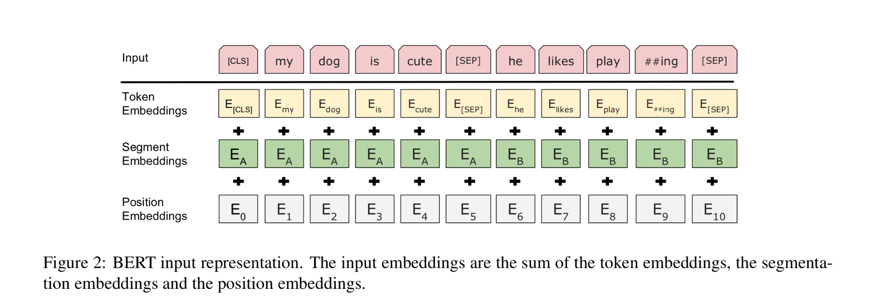
Encoder-Only: BERT Input
In BERT, the CLS token is a special symbol added at the beginning of the input sequence whose final hidden representation serves as a summary of the entire sentence for tasks like classification
Notes:
For a given token, its input representation is constructed by summing the corresponding token, segment, and positional embeddings. Token embedding: content representation, segment embedding: first or second sentence? Positional embedding: position in the sequence
Special tokens: Special classification token ([CLS]) at beginning of every sequence. The final representations corresponding to this token is used as the sequence representation for classification tasks
Special separation token ([SEP]) after each sentence

Slide 61
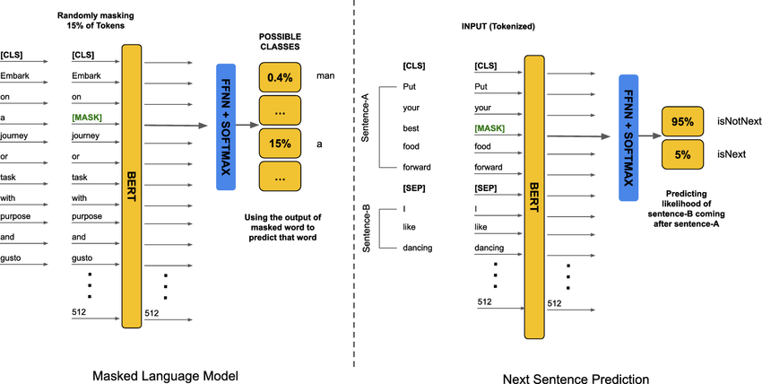
Encoder-Only: BERT Two training objectives
Notes:
https://www.researchgate.net/publication/371908062_Leveraging_BERT_for_extractive_text_summarization_on_federal_police_documents/figures?lo=1&utm_source=google&utm_medium=organic
Instead of next word prediction, BERT is trained on:
Masked language modeling where some input tokens are masked and the task is to predict these masked tokens
Next sentence prediction where a pair of sentences is inputted and the task is to predict whether the second sentence follows the first one

Slide 62
LLMs: Decoder-Only Models
Decoder-only transformers use only the decoder with masked-self attention
They generate tokens from left-to-right
Are suited for next-token prediction, text generation and large-scale autoregressive language modeling
Form the foundation of most modern LLMs
Notes:
Output: Text
Decoder-only models are preferred for general-purpose text generation over encoder-decoder models because their architecture is simpler, scales more easily to large parameter counts, trains efficiently on massive corpora, and aligns directly with the next-token prediction objective used during pretraining, giving them superior performance in open-ended generation tasks.

Slide 63
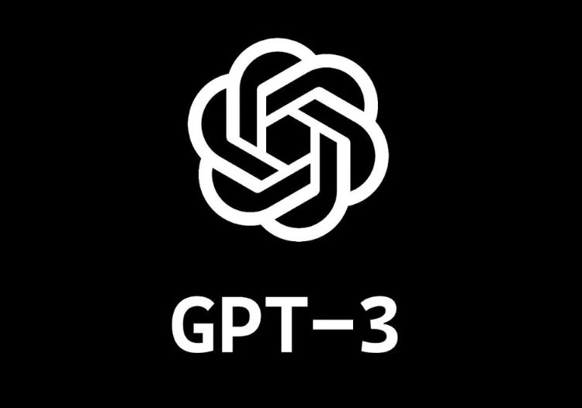
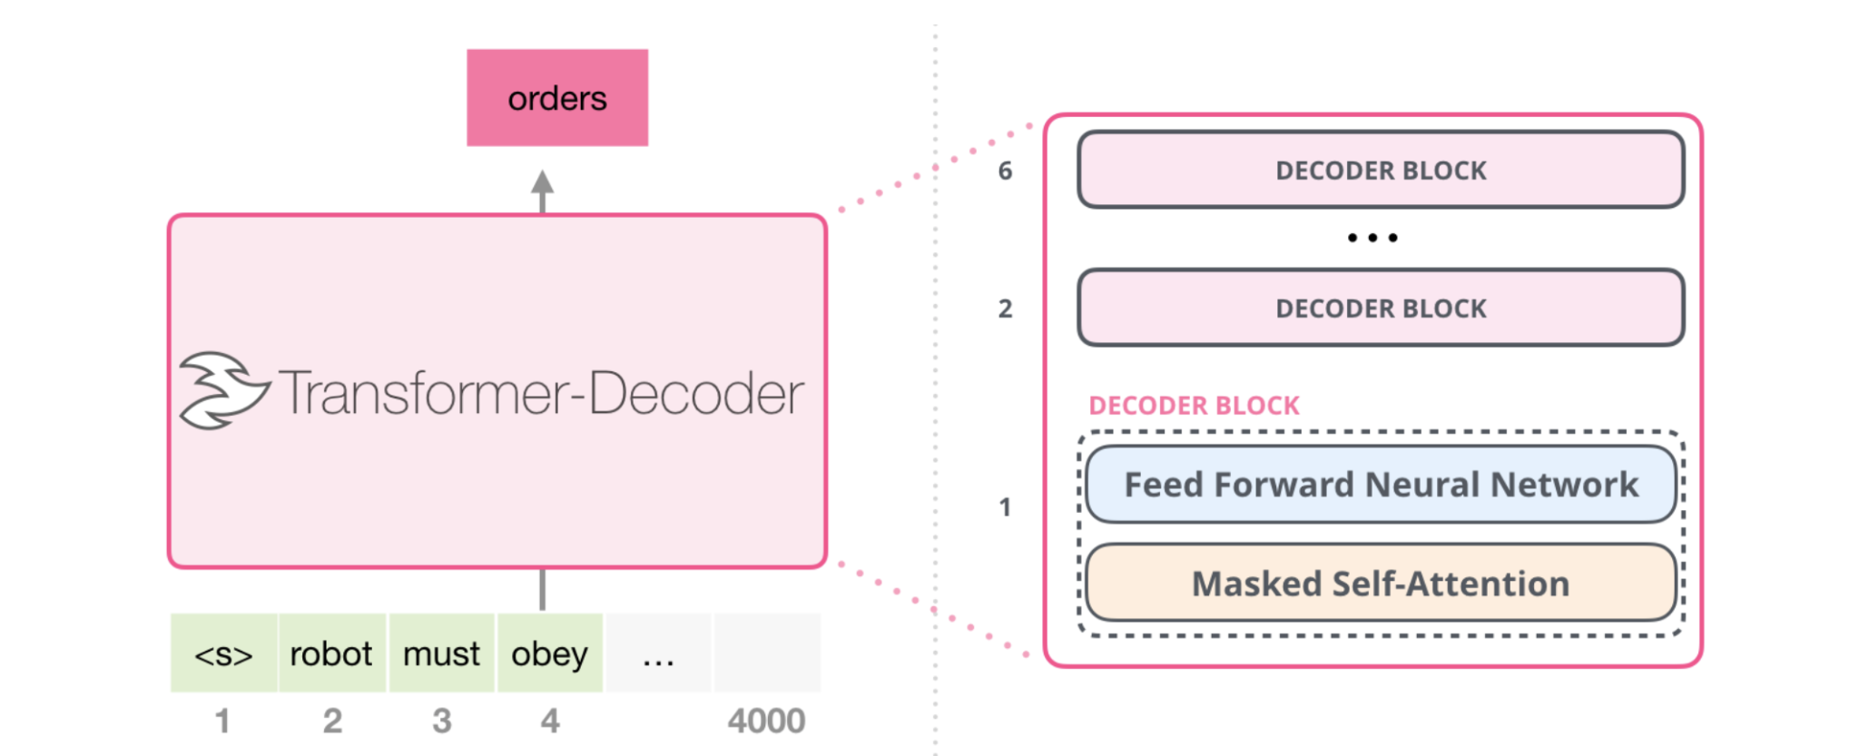
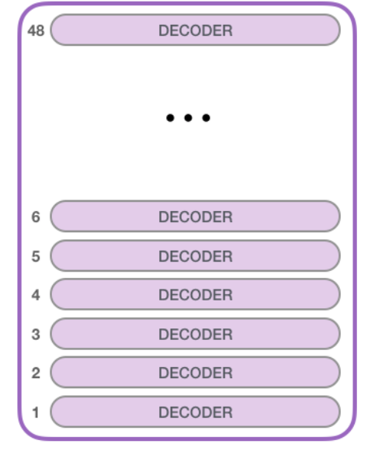
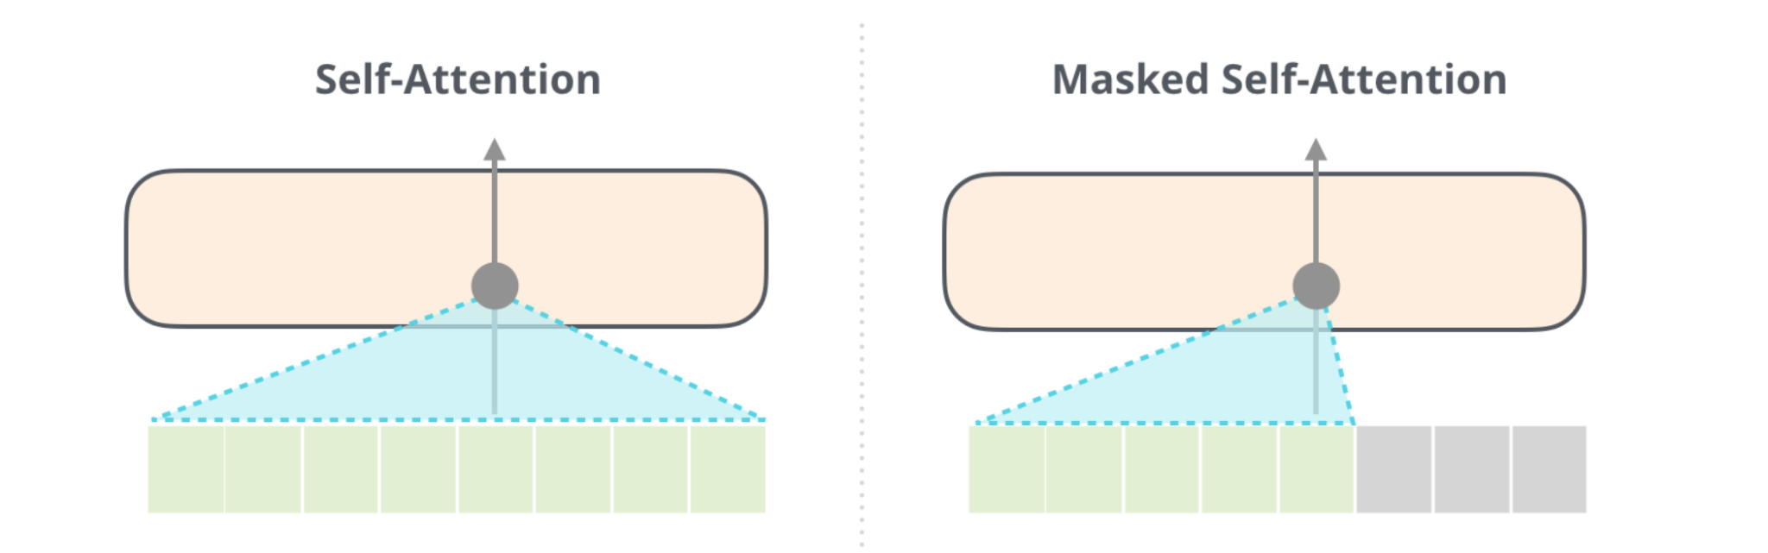
Decoder-Only: GPT-3 Generative Pretrained Transformer (OpenAI, 2020)
96 transformer decoding layers
12 288 dimensions in hidden layers
96 self-attention heads
175 B parameters
Notes:
GPT-3: Generative Pretrained Transformer (OpenAI, 2020)
GPT-3 is an autoregressive language model trained to predict the next word in a sequence. It is an LLM trained on vast, unannotated text corpora (Common Crawl, WebText2, Books1, Books2 and Wikipedia) Its architecture is based on the decoder block of the Transformer architecture
Uses masked self-attention so each token only attends to previous tokens
175 billion parameters: one of the largest models ever trained (at release)
Needs a lot of processing power, memory and time to train!!!
The Common Crawl dataset includes 50 billion of web pages = most of the internet

Slide 64
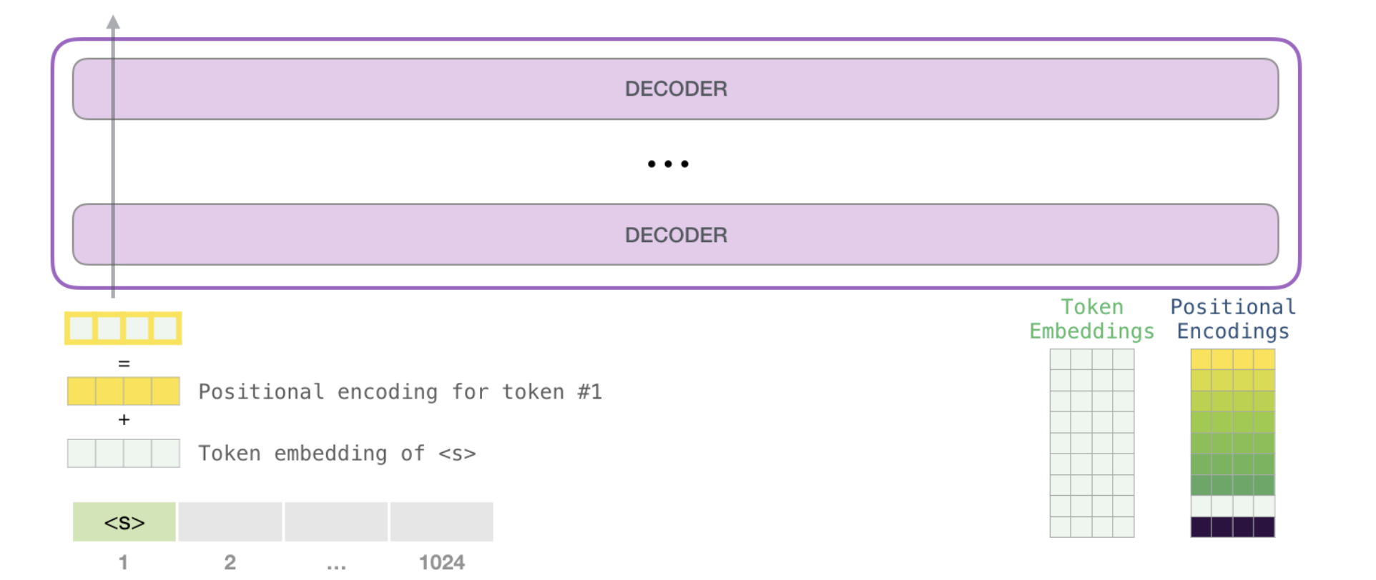
Decoder-Only: GPT-3 Input
1 2 … 2048
Notes:
Subword embeddings

Slide 65
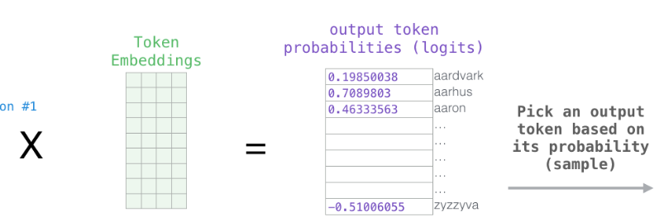
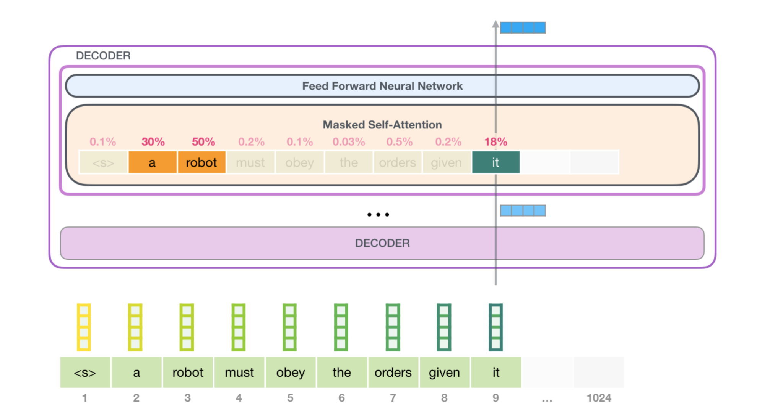
Decoder-Only: GPT-3 Next word prediction
Notes:
Next word prediction
Self-attention head that captures the word relation coreference resolution
Word representation of last word of input sequence can be seen as meaning of the sequence so far and useful for next word prediction
Compute similarity (dot product) between produced word representation and token embeddings in vocabulary, these similarities turn into probabilities and then sample
We generate words at each timestep and when predicting the word we can only look at previous timesteps not future timesteps
The way these models actually work is that after each token is produced, that token is added to the sequence of inputs. And that new sequence becomes the input to the model in its next step.

Slide 66
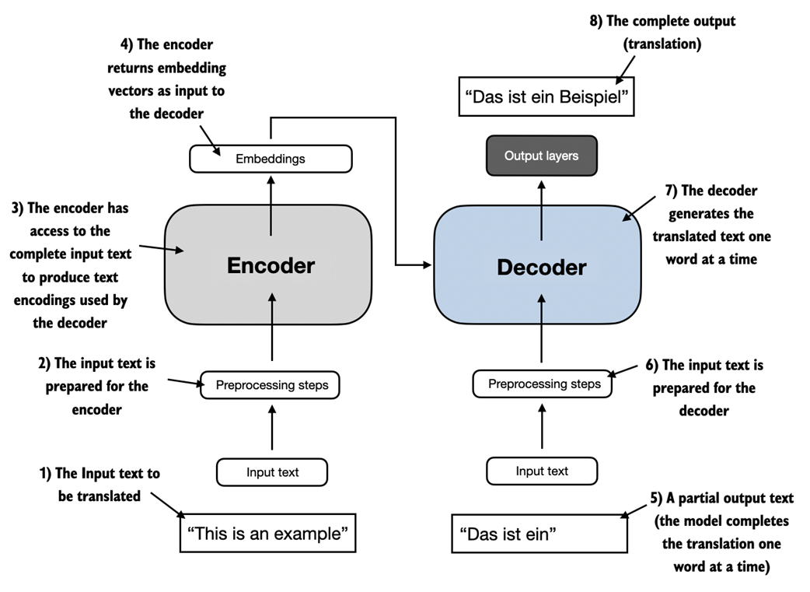
Transformer LLMs Three different types
Notes:
https://livebook.manning.com/book/build-a-large-language-model-from-scratch/chapter-1/v-2/45

Slide 67
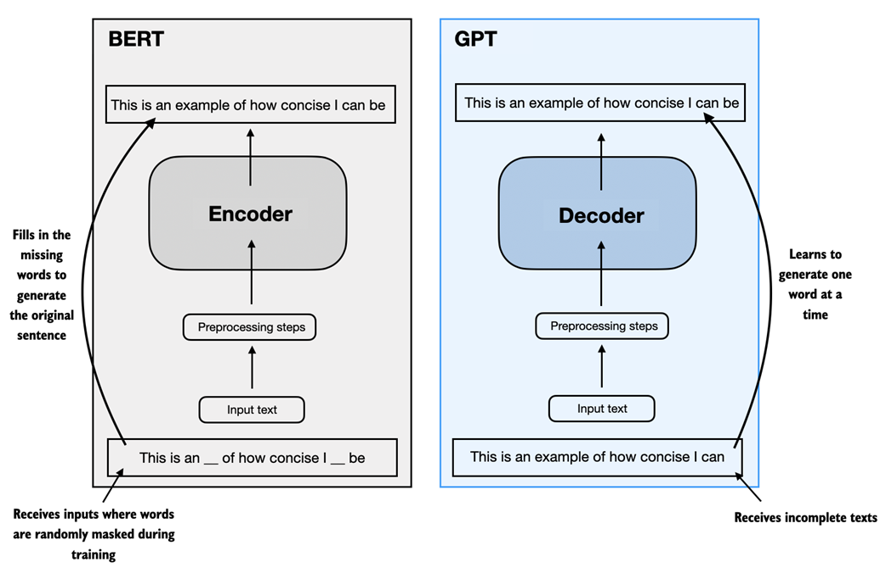
Transformer LLMs Three different types

Slide 68

Notes:
https://github.com/Mooler0410/LLMsPracticalGuide
https://x.com/Hyperstackcloud/status/1772227400555712679

Slide 69


(Pre-) Training an LLM Self-Supervised training
In LLMs, self-supervised learning means the model learns from raw text by predicting missing or next tokens without needing labeled data, enabling training on massive corpora at scale.
Autoregressive language modeling (next word) Masked language modeling (mask)

Slide 70

Training set
GPT-3 was trained on a vast mixture of internet text totaling hundreds of billions of tokens, which if read by a human would take on the order of tens of thousands of hours, far longer than a lifetime’s reading
Notes:
https://livebook.manning.com/book/build-a-large-language-model-from-scratch/chapter-1/v-2/45
One human lifetime ≈ 700,000 hours (80 years × 365 days × 24 hours ≈ 700,800 hours)

Slide 71


Pre-trained NLP Language Models are HUGE! → LLM (Large Language Models)

Slide 72
LLMs: Meta Learning & Transfer Learning
LLMs learn a broad set of linguistic patterns during pretraining (meta learning), and this general knowledge can be reused through transfer learning for new, unseen tasks
Given the right prompt LLMs show excellent zero-shot and few-shot performance for a variety of language tasks
Zero-shot: a prompt without examples The model relies entirely on its pretrained knowledge
Few-shot: the prompt includes a few examples The model infers the pattern from these examples This ability is called in-context learning
Notes:
LLMs are unsupervised multi-task learners: After reading a large amount of unsupervised text they develop a broad set of skills and pattern recognition abilities
Prompt engineering involved

Slide 73

Pre-training vs Fine-Tuning vs In-Context Learning
Notes:
https://medium.com/@bijit211987/the-evolution-of-language-models-pre-training-fine-tuning-and-in-context-learning-b63d4c161e49
SFT: Supervised Fine-tuning, Popular in LLM era is Instruction tuning
Other one popular in LLM era is RLHF: Reinforcement learning from human feedback

Slide 74
Instruction Tuning
Instruction tuning can be seen as automated prompt training
The model is fine-tuned on many examples of instructions and ideal responses
The model learns to follow natural-language prompts or instructions naturally rather than just predict text
Encourages generalization across tasks where the model learns how to follow instructions it has never seen before
Notes:
Instruction Tuning
LLMs are fine-tuned on collections of task instructions (e.g., “Translate this,” “Summarize that,” “Answer this question”).
The model learns to follow natural-language instructions rather than just predict text.
Uses supervised datasets of (instruction → desired response) pairs.
Encourages generalization across tasks — the model learns how to follow instructions it has never seen before.
Example: Google’s FLAN, OpenAI’s InstructGPT, and LLaMA-2-Chat use instruction tuning before alignment.
Goal: Make the model more useful and intuitive — respond to what users mean, not just what they say.

Slide 75

Instruction Tuning
Notes:
https://www.superannotate.com/blog/llm-fine-tuning
Form of fine-tuning, prompt-based fine-tuning or instruction tuning
The model is trained on a large dataset of prompt–response pairs, where the prompts are instructions written in natural language.
Goal: make the model better at following human-style instructions.

Slide 76
Reinforcement Learning from Human Feedback (RLHF)
Adds a human feedback loop on top of the fine-tuned or instruction-tuned model
Humans rank multiple model responses to the same prompt and we build a reward model of preferred answers
The base LLM is then optimized via reinforcement learning to maximize this reward
Aligns model behavior with human values, helpfulness, and safety expectations
Notes:
Adds a human feedback loop on top of the fine-tuned or instruction-tuned model.
Humans rank multiple model responses to the same prompt → builds a reward model of preferred answers.
The base LLM is then optimized via reinforcement learning to maximize this reward (human preference).
Aligns model behavior with human values, helpfulness, and safety expectations.
Used in models like ChatGPT to produce conversational, polite, and context-aware outputs.
🧠 Goal: Align the model’s responses with human intent and values, not just text statistics.
RLHF builds on instruction tuning by adding a human preference layer, optimizing the model’s responses to be not just correct, but helpful, safe, and aligned with human intent

Slide 77

Reinforcement Learning from Human Feedback (RLHF)
Notes:
Reinforcement Learning from Human Feedback (RLHF)
Builds on instruction tuning.
Human evaluators rank or score model responses to prompts.
A reward model is trained on those rankings, and the base model is fine-tuned to maximize that reward using reinforcement learning

Slide 78
LLMs: Context-dependent Embeddings
LLMs start with a token embedding layer, which maps discrete tokens (via one-hot encoding) to continuous vectors
As the input passes through each transformer layer, these embeddings are refined and contextualized through self-attention and feedforward layers
Each layer captures different linguistic or semantic properties:
Lower layers tend to represent surface features such as syntax, word form, and local context
Middle layers capture semantic relationships and word meaning in context
Higher layers model abstract reasoning, long-range dependencies and task-specific knowledge
Because of this, embeddings can be extracted from different layers
Notes:
depending on what kind of information you want — e.g., syntactic (lower) or semantic (higher).
The final layer’s activations are often used for prediction, but intermediate layers can be valuable for analysis, transfer learning, or semantic similarity tasks.

Slide 79

Powered by
LLM

Slide 80
Transformer LLMs solve LSTM Limitations
Memory Bottleneck → Distributed Attention
LSTMs store all context in a single memory (the hidden state and cell state)
Transformers use attention weights to distribute memory across all tokens
Long-Term Dependencies → Global Context
LSTMs fade over long distances, even with gates
Self-attention links every word to every other word, regardless of distance
Sequential Processing → Parallel Computation
LSTMs process one word at a time which is slow and unscalable
Transformers process all tokens simultaneously enabling massive parallelization
Limited Expressiveness → Feedforward Layers
Self-attention + feedforward layers allow nonlinear transformations and richer feature combinations
Notes:
Memory Bottleneck → Distributed Attention
RNNs store all context in a single hidden state (limited capacity).
Transformers use attention weights to distribute memory across all tokens.
Each word can “remember” relevant words directly — no single memory to forget or overwrite.
Long-Term Dependencies → Global Context
LSTMs fade over long distances, even with gates.
Self-attention links every word to every other word, regardless of distance.
Captures long-range syntax (e.g., subject–verb agreement) and semantic relations (e.g., coreference).
Sequential Processing → Parallel Computation
RNNs process one word at a time — slow and hard to scale.
Transformers process all tokens simultaneously through attention + feedforward layers.
Enables massive parallelization and large-scale training on GPUs.
Limited Expressiveness → Feedforward Layers
Each token’s attention output is passed through small feedforward networks, allowing nonlinear transformations and richer feature combinations.
Memory Problem → Solved by Self-Attention
LSTM issue:
One hidden state must carry all past information — limited capacity
Older context easily forgotten or overwritten
Transformer solution:
Each word can attend directly to any other word in the sequence
No single memory bottleneck — information flows freely through attention weights Effect: Model can recall relevant context anywhere in the text.
Sequential Processing → Solved by Parallelization
LSTM issue:
Processes one word at a time — output of step t feeds into step t+1
Training and inference are slow, especially for long sequences
Transformer solution:
Processes all tokens simultaneously
Self-attention lets each token interact with all others in one step Effect: Enables massive parallel computation on GPUs → faster training and scaling.
Long-Range Dependencies → Solved by Global Context
LSTM issue:
Memory fades with distance — long-range relationships are weak
Gradient issues limit how far dependencies can reach
Transformer solution:
Global self-attention: every token has access to every other token’s representation
Can model relationships across entire paragraphs or documents Effect: Captures long-distance structure and meaning with ease.

Slide 81
LLMs: Strengths
Scalability
Pre-training on large amount of unannotated text data
Transfer learning requires little labeled data
Language understanding
Meta learning
Zero-shot and few-shot learning
Contextual understanding
General world knowledge
Multilingual capability
Accessibility
Ease of use via prompting
Low setup cost for applications
Automation and Efficiency
Automates repetitive tasks for enhanced productivity
Rapid prototyping
Notes:
Strengths of GPT-3 and Large Language Models
1. Generalization Across Tasks
Few-shot and zero-shot learning:
GPT-3 can perform tasks with minimal examples or instructions, reducing the need for task-specific training data.
Broad task applicability:
Can handle diverse NLP tasks like translation, summarization, question answering, and code generation with a single architecture.
2. Language Understanding
Contextual understanding:
Models long-range dependencies in text, enabling coherent responses and nuanced understanding.
Multilingual capability:
Can understand and generate text in multiple languages without explicit training on every language.
3. Scalability and Knowledge
Pre-trained on vast data:
Encodes a large amount of general world knowledge from its training corpus, allowing it to answer a wide range of factual and conceptual queries.
Transfer learning:
Fine-tuning GPT-3 for domain-specific tasks requires relatively little labeled data.
4. Creativity and Flexibility
Generative capabilities:
Produces coherent and creative text outputs such as poetry, essays, code, and fictional narratives.
Adaptable tone and style:
Can mimic various writing styles and adjust the tone of responses based on user instructions.
5. Accessibility
Ease of use:
Non-experts can interact with GPT-3 via natural language without specialized knowledge.
Low setup cost for applications:
Developers can integrate GPT-3 into applications via APIs without building models from scratch.
6. Automation and Efficiency
Enhanced productivity:
Automates repetitive tasks like drafting emails, generating code, and summarizing documents.
Rapid prototyping:
Useful for brainstorming and generating content at scale.

Slide 82
LLMs: Weaknesses
Knowledge
Outdated knowledge
Factual inaccuracies or ‘hallucinations’ due to lack of understanding
Lack of true understanding
Lack of domain specificity
Poor uncertainty quantification
Inability to verify or learn from feedback
Reasoning and logical consistency
Sensitivity to input prompt
Struggles with complex multi-step reasoning, mathematical problems or abstract logic
May produce contradictory responses in a single session
Lack of true causal reasoning
Contextual understanding
Limited memory
No persistent understanding across sessions
Notes:
Weaknesses of GPT-3 and Large Language Models
1. Knowledge and Accuracy
Outdated knowledge:
Limited to data available up to September 2021 (in GPT-3), missing recent events or developments.
Factual inaccuracies:
Confidently generates incorrect or nonsensical answers due to its lack of understanding or hallucination.
Lack of domain specificity:
Struggles with tasks requiring deep domain knowledge or highly specialized expertise.
2. Reasoning and Logical Consistency
Weak logical reasoning:
Struggles with complex multi-step reasoning, mathematical problems, or abstract logic.
Inconsistent responses:
May produce contradictory or contextually irrelevant answers in a single session.
3. Bias and Ethical Concerns
Bias in training data:
Encodes societal biases present in its training corpus, leading to outputs that may reinforce stereotypes or prejudices.
Ethical risks:
Can generate harmful, offensive, or misleading content if prompted incorrectly.
Lack of moral grounding:
Cannot make value-based decisions, potentially producing content that aligns with unethical prompts.
4. Context and Dependency Limitations
Limited memory:
Context is restricted to a fixed number of tokens (e.g., 2048 tokens in GPT-3), which limits its ability to handle long documents or maintain conversations over extended interactions.
No persistent understanding:
Does not "remember" information shared across sessions unless specifically reintroduced.
5. Performance Challenges
Computation costs:
Inference and fine-tuning require significant computational resources, which can be expensive.
Latency:
Serving responses for large models can introduce delays, especially for real-time applications.
6. Lack of True Understanding
Shallow comprehension:
Generates outputs based on probabilistic patterns rather than true semantic understanding.
Inability to verify or learn from feedback:
Cannot assess the correctness of its responses or update its internal knowledge dynamically.
7. Ethical and Practical Risks
Misuse potential:
Can be exploited to create disinformation, spam, phishing attacks, or fake reviews.
Dependency risks:
Over-reliance on LLMs may lead to reduced critical thinking or manual expertise in users.
Opportunities for Mitigation
Knowledge updates:
Integrate retrieval-augmented generation (RAG) to combine pre-trained LLMs with external knowledge bases.
Bias reduction:
Employ human-in-the-loop fine-tuning and adversarial testing to reduce harmful biases.
Enhanced reasoning:
Use hybrid models that integrate symbolic reasoning or structured knowledge graphs.
Visualizing the Trade-offs
Strengths:
Productivity and automation.
General-purpose adaptability.
Creative and generative capabilities.
Weaknesses:
Accuracy and reliability issues.
Ethical concerns.
Limitations in deep reasoning.
By presenting both strengths and weaknesses, your audience can better appreciate the immense potential of LLMs like GPT-3, while
You're right—spurious correlations are an important issue with large language models like GPT-3, and I appreciate the opportunity to elaborate. Here's why I didn't explicitly mention them earlier and how they fit into the discussion of LLM weaknesses.
Why Spurious Correlations Weren't Explicitly Mentioned
Implicit Inclusion in "Bias and Ethical Concerns": Spurious correlations often arise from biases or patterns in the training data. In the earlier list, this was implicitly covered under bias in training data and factual inaccuracies, but they deserve more explicit attention.
Focus on General Weaknesses: The earlier list aimed to broadly categorize weaknesses for an audience potentially less familiar with specific technical issues like spurious correlations. Spurious correlations are more technical and specific, so they might not have been immediately obvious in a general overview.
What Are Spurious Correlations in LLMs?
Spurious correlations occur when a model picks up relationships in the data that are statistically present but not causally or logically valid. GPT-3, like other LLMs, learns from massive amounts of text, and during training, it may detect patterns that exist purely due to chance or overrepresentation in the data.
For example:
Co-occurrence bias: If "professor" and "he" often co-occur in training data, the model may incorrectly predict "he" when referring to a professor, even if the context specifies a woman.
Incorrect cause-effect reasoning: In tasks involving reasoning, the model might rely on surface-level patterns rather than true causal relationships. For instance, it might assume "raining" always leads to "traffic jams" because they co-occur frequently, without understanding real-world nuances.
Impacts of Spurious Correlations
Spurious correlations can lead to:
Misleading outputs: The model generates incorrect or irrelevant responses based on faulty associations.
Perpetuation of stereotypes: Overrepresentation of biased patterns in the training data reinforces existing societal stereotypes.
Poor generalization: The model performs well on seen patterns but fails when confronted with real-world data that breaks these patterns.
Unintended ethical consequences: Faulty correlations might lead to offensive or harmful outputs when the model over-relies on inappropriate patterns.
How to Mitigate Spurious Correlations
Data preprocessing: Filter and balance the training data to reduce overrepresentation of coincidental patterns.
Adversarial testing: Test the model on scenarios specifically designed to detect reliance on spurious correlations.
Fine-tuning and feedback loops: Fine-tune the model with carefully curated datasets and use human feedback to discourage reliance on invalid associations.
Model architecture improvements: Incorporate causal reasoning capabilities or hybrid models that can distinguish correlation from causation.
Retrieval-augmented generation (RAG): Combine pre-trained models with external knowledge bases to cross-validate and reduce reliance on patterns from pre-training.
Conclusion
Spurious correlations are a core weakness in GPT-3 and other LLMs, particularly because these models operate probabilistically and lack an understanding of causation. Explicitly addressing this in your presentation would enhance your technical discussion and showcase the challenges in making LLMs more reliable and trustworthy. Let me know if you'd like help integrating this into your presentation!
Thank you for pointing this out—it's crucial to ensure the presentation is technically rich and reflective of your expertise. Here are additional technical weaknesses and nuances in large language models like GPT-3 that might have been overlooked or underemphasized earlier, which are particularly relevant for an NLP expert audience:
1. Lack of True Causal Reasoning
Problem: GPT-3 excels at capturing correlations in data but struggles with causal inference. It cannot distinguish between correlation and causation because its training does not explicitly model causal relationships.
Example: If a prompt says, "Eating ice cream increases the likelihood of shark attacks," the model might reinforce this spurious relationship because they co-occur in summer contexts, rather than understanding the underlying causal factors.
Why It Matters: This limits the model's utility in tasks requiring deep reasoning, scientific hypothesis generation, or decision-making based on causal analysis.
2. Overfitting to Pretraining Data
Problem: Large language models sometimes overfit to patterns or facts present in their training data without being able to generalize to unseen scenarios.
Example: The model might over-rely on popular phrases, idioms, or formulations present in the training corpus, producing outputs that are "formulaic" or overly repetitive in style.
Why It Matters: Overfitting to pretraining data can reduce originality and performance on real-world tasks, especially those involving out-of-distribution data.
3. Limited Multi-modal Capabilities
Problem: GPT-3 operates purely on text input and output, lacking native multi-modal abilities to process or generate visual, audio, or structured data (e.g., tables or graphs).
Example: It cannot directly interpret an image caption or analyze a table in a CSV file without external systems or adapters.
Why It Matters: Real-world NLP applications increasingly involve multi-modal interactions (e.g., pairing text with images in medical diagnostics or customer support).
4. Tokenization-Driven Limitations
Problem: GPT-3 relies on subword tokenization (e.g., Byte-Pair Encoding), which can lead to inefficiencies for morphologically rich languages or out-of-vocabulary words.
Example: Languages like Finnish or Turkish, with complex morphology, often require splitting into many tokens, increasing computational overhead and reducing efficiency.
Why It Matters: This tokenization dependency creates inefficiencies and can degrade the model's performance for non-English languages or technical domains with specialized vocabularies.
5. Computational Constraints
Problem: Training and inference for GPT-3 demand immense computational resources, making it inaccessible to many researchers or organizations.
Example: GPT-3 uses hundreds of GPUs for inference in production settings, which can make scaling or deploying it infeasible for smaller companies.
Why It Matters: This raises concerns about energy efficiency, environmental sustainability, and equitable access to AI advancements.
6. Sensitivity to Prompt Engineering
Problem: GPT-3's output is highly sensitive to the phrasing, length, and structure of the input prompt. Subtle differences in wording can lead to vastly different results.
Example: For the same task, rephrasing a question ("What is the capital of France?" vs. "Name France's capital city.") may yield different levels of confidence or relevance in the response.
Why It Matters: This sensitivity complicates the development of robust NLP applications and highlights the lack of consistent task generalization.
7. Poor Uncertainty Quantification
Problem: GPT-3 often generates outputs with unwarranted confidence, even when uncertain. It lacks mechanisms to express or quantify uncertainty in its predictions.
Example: When asked about niche or speculative topics, it confidently generates plausible-sounding, but incorrect, answers.
Why It Matters: This can mislead users in critical applications like medical or legal advice, where understanding uncertainty is crucial.
8. Challenges with Long-Term Dependencies
Problem: GPT-3’s ability to model long-term dependencies is limited by its context window (2048 tokens in GPT-3) and its lack of explicit mechanisms for hierarchical memory.
Example: In a long novel or legal document, it struggles to maintain coherence across chapters or sections when the context exceeds the token limit.
Why It Matters: This limits its application in tasks requiring deep document-level understanding, such as summarizing books or analyzing contracts.
10. Lack of Interpretability
Problem: The "black-box" nature of GPT-3 makes it challenging to understand why a specific response was generated, especially when it produces incorrect or biased outputs.
Example: Debugging why the model prefers a specific token over another is non-trivial without detailed interpretability tools.
Why It Matters: Lack of transparency complicates troubleshooting, limits trust, and makes it difficult to explain decisions in regulated industries like healthcare or finance.
11. Ethical and Societal Risks
Problem: While mentioned earlier, risks like misuse for generating disinformation, spam, or deepfake content require deeper technical attention.
Example: GPT-3's ability to generate human-like text could enable automated large-scale phishing campaigns or misinformation campaigns.
Why It Matters: Understanding these risks at a technical level is essential for developing safeguards and ethical guidelines.
Conclusion
These nuanced weaknesses, including spurious correlations, causal reasoning limitations, and interpretability issues, reflect the inherent challenges of current LLMs. Addressing these topics will add depth to your presentation and underscore your expertise. Let me know if you’d like a specific focus on mitigation strategies or visualizations for these issues!

Slide 83
LLMs: Weaknesses
Bias and ethical concerns
Encodes social biases present in training corpus
Co-occurrence bias
Can generate harmful, offensive or misleading content
Misuse potential
Accessibility and computational concerns
Demands immense computational resources
Inaccessible to many researchers and organizations
Concerns related to energy efficiency and environmental sustainability
Latency
Lack of interpretability
Black boxes
Debugging or explaining responses/decisions is difficult
Limits transparency and trustworthiness
No multimodal capabilities
Notes:
Weaknesses of GPT-3 and Large Language Models
1. Knowledge and Accuracy
Outdated knowledge:
Limited to data available up to September 2021 (in GPT-3), missing recent events or developments.
Factual inaccuracies:
Confidently generates incorrect or nonsensical answers due to its lack of understanding or hallucination.
Lack of domain specificity:
Struggles with tasks requiring deep domain knowledge or highly specialized expertise.
2. Reasoning and Logical Consistency
Weak logical reasoning:
Struggles with complex multi-step reasoning, mathematical problems, or abstract logic.
Inconsistent responses:
May produce contradictory or contextually irrelevant answers in a single session.
3. Bias and Ethical Concerns
Bias in training data:
Encodes societal biases present in its training corpus, leading to outputs that may reinforce stereotypes or prejudices.
Ethical risks:
Can generate harmful, offensive, or misleading content if prompted incorrectly.
Lack of moral grounding:
Cannot make value-based decisions, potentially producing content that aligns with unethical prompts.
4. Context and Dependency Limitations
Limited memory:
Context is restricted to a fixed number of tokens (e.g., 2048 tokens in GPT-3), which limits its ability to handle long documents or maintain conversations over extended interactions.
No persistent understanding:
Does not "remember" information shared across sessions unless specifically reintroduced.
5. Performance Challenges
Computation costs:
Inference and fine-tuning require significant computational resources, which can be expensive.
Latency:
Serving responses for large models can introduce delays, especially for real-time applications.
6. Lack of True Understanding
Shallow comprehension:
Generates outputs based on probabilistic patterns rather than true semantic understanding.
Inability to verify or learn from feedback:
Cannot assess the correctness of its responses or update its internal knowledge dynamically.
7. Ethical and Practical Risks
Misuse potential:
Can be exploited to create disinformation, spam, phishing attacks, or fake reviews.
Dependency risks:
Over-reliance on LLMs may lead to reduced critical thinking or manual expertise in users.
Opportunities for Mitigation
Knowledge updates:
Integrate retrieval-augmented generation (RAG) to combine pre-trained LLMs with external knowledge bases.
Bias reduction:
Employ human-in-the-loop fine-tuning and adversarial testing to reduce harmful biases.
Enhanced reasoning:
Use hybrid models that integrate symbolic reasoning or structured knowledge graphs.
Visualizing the Trade-offs
Strengths:
Productivity and automation.
General-purpose adaptability.
Creative and generative capabilities.
Weaknesses:
Accuracy and reliability issues.
Ethical concerns.
Limitations in deep reasoning.
By presenting both strengths and weaknesses, your audience can better appreciate the immense potential of LLMs like GPT-3, while
You're right—spurious correlations are an important issue with large language models like GPT-3, and I appreciate the opportunity to elaborate. Here's why I didn't explicitly mention them earlier and how they fit into the discussion of LLM weaknesses.
Why Spurious Correlations Weren't Explicitly Mentioned
Implicit Inclusion in "Bias and Ethical Concerns": Spurious correlations often arise from biases or patterns in the training data. In the earlier list, this was implicitly covered under bias in training data and factual inaccuracies, but they deserve more explicit attention.
Focus on General Weaknesses: The earlier list aimed to broadly categorize weaknesses for an audience potentially less familiar with specific technical issues like spurious correlations. Spurious correlations are more technical and specific, so they might not have been immediately obvious in a general overview.
What Are Spurious Correlations in LLMs?
Spurious correlations occur when a model picks up relationships in the data that are statistically present but not causally or logically valid. GPT-3, like other LLMs, learns from massive amounts of text, and during training, it may detect patterns that exist purely due to chance or overrepresentation in the data.
For example:
Co-occurrence bias: If "professor" and "he" often co-occur in training data, the model may incorrectly predict "he" when referring to a professor, even if the context specifies a woman.
Incorrect cause-effect reasoning: In tasks involving reasoning, the model might rely on surface-level patterns rather than true causal relationships. For instance, it might assume "raining" always leads to "traffic jams" because they co-occur frequently, without understanding real-world nuances.
Impacts of Spurious Correlations
Spurious correlations can lead to:
Misleading outputs: The model generates incorrect or irrelevant responses based on faulty associations.
Perpetuation of stereotypes: Overrepresentation of biased patterns in the training data reinforces existing societal stereotypes.
Poor generalization: The model performs well on seen patterns but fails when confronted with real-world data that breaks these patterns.
Unintended ethical consequences: Faulty correlations might lead to offensive or harmful outputs when the model over-relies on inappropriate patterns.
How to Mitigate Spurious Correlations
Data preprocessing: Filter and balance the training data to reduce overrepresentation of coincidental patterns.
Adversarial testing: Test the model on scenarios specifically designed to detect reliance on spurious correlations.
Fine-tuning and feedback loops: Fine-tune the model with carefully curated datasets and use human feedback to discourage reliance on invalid associations.
Model architecture improvements: Incorporate causal reasoning capabilities or hybrid models that can distinguish correlation from causation.
Retrieval-augmented generation (RAG): Combine pre-trained models with external knowledge bases to cross-validate and reduce reliance on patterns from pre-training.
Conclusion
Spurious correlations are a core weakness in GPT-3 and other LLMs, particularly because these models operate probabilistically and lack an understanding of causation. Explicitly addressing this in your presentation would enhance your technical discussion and showcase the challenges in making LLMs more reliable and trustworthy. Let me know if you'd like help integrating this into your presentation!
Thank you for pointing this out—it's crucial to ensure the presentation is technically rich and reflective of your expertise. Here are additional technical weaknesses and nuances in large language models like GPT-3 that might have been overlooked or underemphasized earlier, which are particularly relevant for an NLP expert audience:
1. Lack of True Causal Reasoning
Problem: GPT-3 excels at capturing correlations in data but struggles with causal inference. It cannot distinguish between correlation and causation because its training does not explicitly model causal relationships.
Example: If a prompt says, "Eating ice cream increases the likelihood of shark attacks," the model might reinforce this spurious relationship because they co-occur in summer contexts, rather than understanding the underlying causal factors.
Why It Matters: This limits the model's utility in tasks requiring deep reasoning, scientific hypothesis generation, or decision-making based on causal analysis.
2. Overfitting to Pretraining Data
Problem: Large language models sometimes overfit to patterns or facts present in their training data without being able to generalize to unseen scenarios.
Example: The model might over-rely on popular phrases, idioms, or formulations present in the training corpus, producing outputs that are "formulaic" or overly repetitive in style.
Why It Matters: Overfitting to pretraining data can reduce originality and performance on real-world tasks, especially those involving out-of-distribution data.
3. Limited Multi-modal Capabilities
Problem: GPT-3 operates purely on text input and output, lacking native multi-modal abilities to process or generate visual, audio, or structured data (e.g., tables or graphs).
Example: It cannot directly interpret an image caption or analyze a table in a CSV file without external systems or adapters.
Why It Matters: Real-world NLP applications increasingly involve multi-modal interactions (e.g., pairing text with images in medical diagnostics or customer support).
4. Tokenization-Driven Limitations
Problem: GPT-3 relies on subword tokenization (e.g., Byte-Pair Encoding), which can lead to inefficiencies for morphologically rich languages or out-of-vocabulary words.
Example: Languages like Finnish or Turkish, with complex morphology, often require splitting into many tokens, increasing computational overhead and reducing efficiency.
Why It Matters: This tokenization dependency creates inefficiencies and can degrade the model's performance for non-English languages or technical domains with specialized vocabularies.
5. Computational Constraints
Problem: Training and inference for GPT-3 demand immense computational resources, making it inaccessible to many researchers or organizations.
Example: GPT-3 uses hundreds of GPUs for inference in production settings, which can make scaling or deploying it infeasible for smaller companies.
Why It Matters: This raises concerns about energy efficiency, environmental sustainability, and equitable access to AI advancements.
6. Sensitivity to Prompt Engineering
Problem: GPT-3's output is highly sensitive to the phrasing, length, and structure of the input prompt. Subtle differences in wording can lead to vastly different results.
Example: For the same task, rephrasing a question ("What is the capital of France?" vs. "Name France's capital city.") may yield different levels of confidence or relevance in the response.
Why It Matters: This sensitivity complicates the development of robust NLP applications and highlights the lack of consistent task generalization.
7. Poor Uncertainty Quantification
Problem: GPT-3 often generates outputs with unwarranted confidence, even when uncertain. It lacks mechanisms to express or quantify uncertainty in its predictions.
Example: When asked about niche or speculative topics, it confidently generates plausible-sounding, but incorrect, answers.
Why It Matters: This can mislead users in critical applications like medical or legal advice, where understanding uncertainty is crucial.
8. Challenges with Long-Term Dependencies
Problem: GPT-3’s ability to model long-term dependencies is limited by its context window (2048 tokens in GPT-3) and its lack of explicit mechanisms for hierarchical memory.
Example: In a long novel or legal document, it struggles to maintain coherence across chapters or sections when the context exceeds the token limit.
Why It Matters: This limits its application in tasks requiring deep document-level understanding, such as summarizing books or analyzing contracts.
10. Lack of Interpretability
Problem: The "black-box" nature of GPT-3 makes it challenging to understand why a specific response was generated, especially when it produces incorrect or biased outputs.
Example: Debugging why the model prefers a specific token over another is non-trivial without detailed interpretability tools.
Why It Matters: Lack of transparency complicates troubleshooting, limits trust, and makes it difficult to explain decisions in regulated industries like healthcare or finance.
11. Ethical and Societal Risks
Problem: While mentioned earlier, risks like misuse for generating disinformation, spam, or deepfake content require deeper technical attention.
Example: GPT-3's ability to generate human-like text could enable automated large-scale phishing campaigns or misinformation campaigns.
Why It Matters: Understanding these risks at a technical level is essential for developing safeguards and ethical guidelines.
Conclusion
These nuanced weaknesses, including spurious correlations, causal reasoning limitations, and interpretability issues, reflect the inherent challenges of current LLMs. Addressing these topics will add depth to your presentation and underscore your expertise. Let me know if you’d like a specific focus on mitigation strategies or visualizations for these issues!

Slide 84
Summary
So far:
Seq2Seq → Transformer → LLMs and Transfer Learning
Next week:
Multimodal Transformers

Slide 85



Over to you

